Slide 1
ABSTRACT
The main purpose of this student information management system (SIMS),is a management information system for education establishments to manage student data.
In the Current system all the activities are done manually. It is very time consuming and costly. Our student management system deals with the various activities related to the students. For every colleges of their important task for people administration department is to manage student data information of the details in a the procedure oriented system manner with of latest inform updates for every year for which need to be available for easy access. In order to provide this service we designed simple follow of the students information role management system enter project which has various of modules which is helpful for the student administration to the of efficiently faculty manages .
Keywords: - student information management
System, student information activity,
Administration process, managing capability.

Slide 2
TABLE OF CONTENTS
Introduction
System Requirement Specification
Technology overview
Project description
Snapshots
Scope of the project
Limitation
Testing
Contribution in project
Bibliography

Slide 3
Introduction
Purpose:
The objective of Student information System is to allow the administrator of any organization to edit and find out the personal details of a student and allows the student to keep up to date his profile .It’ll also facilitate keeping all the records of students, such as their id, name, mailing address, phone number, DOB etc. So all the information about an student will be available in a few seconds.
Overall, it’ll make Student Information Management an easier job for the administrator and the student of any organization.
The main purpose of this SRS document is to illustrate the requirements of the project Student information System and is intended to help any organization to maintain and manage its student’s personal data.

Slide 4
Scope :
Without a Student information System, managing and maintaining the details of the student is a tedious job for any organization.
Student Information system will store all the details of the students including their background information, educational qualifications, personal details and all the information related to their resume.
Login module:
Login module will help in authentication of user
accounts.
Users who have valid login id and password can
only login into their respective accounts.
Search module:
Suppose there are hundreds of students and from this we have to search a particular student and we know the name of the student .In
manual system it is a tedious task though we know the name of the student, but using this module we can easily search the student by specifying the name of the student in the search criteria. Thus this module will help the
administrator in searching the student with various criteria easily.

Slide 5
Registration Module and Account Management:
This module will help the student get
registered from anywhere if internet is present.
This module will really simplify the task of on
paper registration. Also after successful
registration the user can update information and
change their password as and when required.
User Management:
This module will help the administrator in
enabling/disabling a user account and updating
user information as required.
Purpose of project is to maintain details of the
students such as storing information about:
Student id
Student password
Student name
Student DOB
Student mailing address
Gender
Registration date
Student status
Contact no
Qualification
City
Resume
Image

Slide 6
Definitions, Acronyms and Abbreviations :
Personal details: Details of student such as user id, phone number, address, image, resume, e-mail address etc.
Contact details: Details of contact associated with the student.
SRS: System requirement Specification
WWW: World Wide Web
Administrator: A Login Id representing the user is an administrator & can access all the records details.
Technologies :
PHP.
MYSQL
JAVASCRIPT
HTML
CSS
Product Perspective :
The website Student Information System is aimed towards recording a considerable number of student records and needs online assistance for
managing records of students. Website should be user-friendly, ‘quick to learn’ and reliable website for the above purpose.
It is intended to be a stand-alone product and should not depend on the availability of other
website.

Slide 7
Name of the Project: Student Information
Management System
Objectives:
Online registration of students
Maintenance of student records
Searching student records
Users Views:
Administrator
Student
Platform
Operating System: Microsoft Windows
Technologies Used:
Front End: HTML and Javascript
Web designing language: PHP
RDBMS(Back end): MySQL
Software Requirements:
PHP 5.0
APACHE HTTP Server
Dreamweaver, FrontPage for Front End
Programming
Microsoft Windows or Linux

Slide 8
Hardware Requirements:
Intel Pentium IV processor or equivalent
or higher
512 MB Ram or Higher
20 GB HDD or Higher
Network Connectivity

Slide 9
The system will also have an administrator who has full-fledged rights with regards to performing all actions related to control and management of the website.
Product Functions :
There are two different users who will be using this product:
Administrator who can view and edit the details of any students.
Students who can view their details as well as they can edit their details.
The features that are available to the Administrator are:
An Administrator can login into the system and perform any of the available operations.
Can enable/disable student.
Can edit student information to the database.
Can make search for a specific student.
Can access all the details of the student.
The features that are available to the student are:
Student can login into the system and can perform any of the available options.
Can view his/her personal details.
Can edit his/her personal details
Can upload his/her resume.
Can upload his/her image.

Slide 10
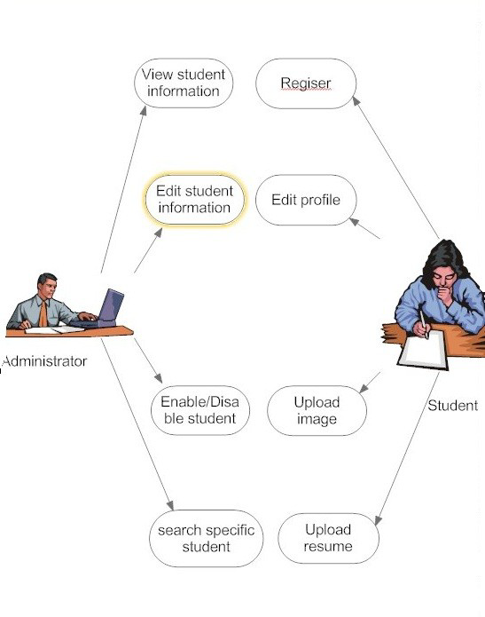
User Classes and Characteristics :
There are mainly two kinds of users for the product.
The users include:
Administrator
Student
Operating Environment :
The product can run on any browser.
Constraints :
Every user must be comfortable using computer.
All operations are in English so user must have basic knowledge of English.
USE CASE MODEL

Slide 11
Administrator: Responsible for managing student
records
Login into the website
Update student details
Search student details
Display student details
Enable/Disable student
2. Student: Has the access rights to view and edit their personal details.
Login into the website
Display student details
Edit their details
Upload their images
Upload their resumes
Assumptions & dependencies
Administrator is created in the system already.
Roles and tasks are predefined.
Use Case Reports
Use-case: Login into the website
Goal in context: Gain access to the website
Brief Description: This use case is used when the administrator wants to access the website to enable/disable/update the personal details of
the student.

Slide 12
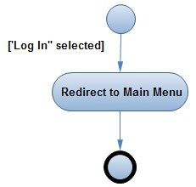
Preconditions: The Administrator must be logged onto the website in order for this use case to begin
Basic Flow:
The Website prompts the administrator for the user name and password.
The Administrator enters the user name and password.
The Website verifies the password and sets the user’s authorization.
The Administrator is given access to the Website to perform his tasks.
Alternative Flow:
The administrator enters invalid username and password then he will not be allowed to enter the website.
Post conditions: The website state is unchanged by this use case.
Use Case Report-
Login into
the website

Slide 13
Use Case : Display student details
Goal in context: View the details of a student
Brief Description: This use case is used when the administrator wants to view the personal details of the students already existing in the database on the screen.
Preconditions:
The Administrator must be logged into the system in order for this use
case to begin
The details of the student must pre-exist in the database
The student id must be entered correctly.
Basic Flow:
The Administrator logs onto the System.
The Administrator search the student from following keys:-
Student id
First/last name
Registration date
status
The System prompts for the student detail from one of the above keys.
The student details are displayed on the screen.

Slide 14
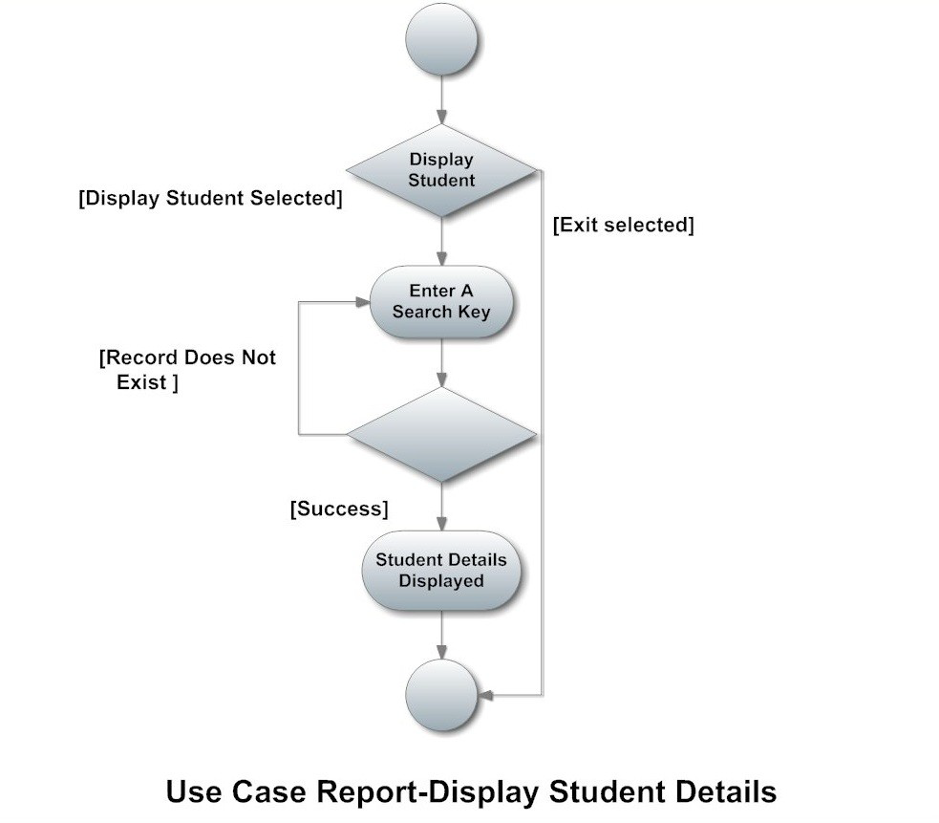
Alternative Flow:
Student Not Found
If in the Display a student sub-flows, a student with the specified id number does
not exist, The system displays an error message.
Then the Administrator can enter a different id number or cancel the operation, at which point the use case ends.
Post conditions:
The student details are displayed on the screen already existing in the system.
The state of the system remains unchanged.

Slide 15
Use Case : Edit student details
Goal in context: Edit the details of a student
Brief Description: This use case is used when the administrator wants to edit the personal details of the himself/herself already existing in the database.
Preconditions:
The Administrator must be logged into the system in order for this use case to begin.
The details of the student must pre-exist in the database
Basic Flow:
The Administrator logs onto the System.
The Administrator can edit following keys:-
First/last name
Gender
DOB
Contact no
Qualification
City
Email1
Email2
Address
Description
The Website updates the database according to edited details.
The student details are edited in the database.

Slide 16
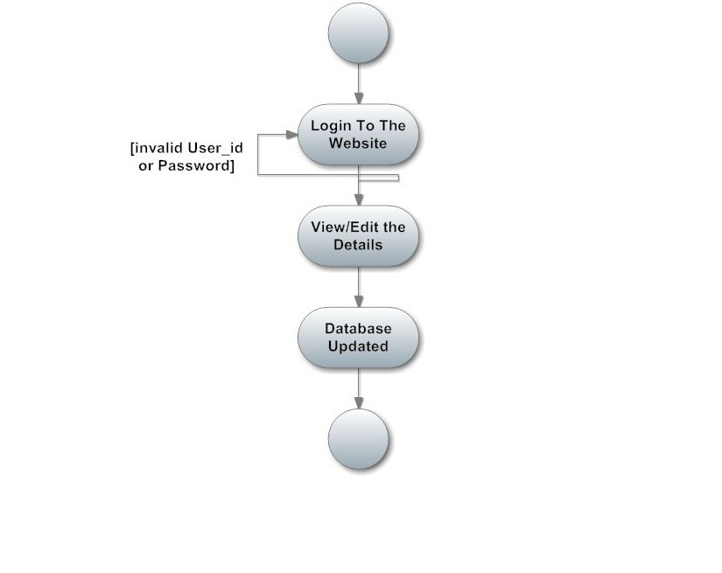
Alternative Flow:
There is no alternative flow of this use case diagram.
Post conditions:
The student details get updated in the database.

Slide 17
Use Case : student registration
Goal in context: Registration of a student
Brief Description: This use case is used when the student register himself/herself in the database online.
Preconditions:
The Student must accessed the website in order for this use case to begin.
The user id must be unique and entered correctly.
Basic Flow:
The Student enters into the website.
The student fill his/her details from the following keys:-
Student id
password
First/last name
Status
Gender
DOB
Contact no
Qualification
City
Email1
Email2
Address
Description

Slide 18
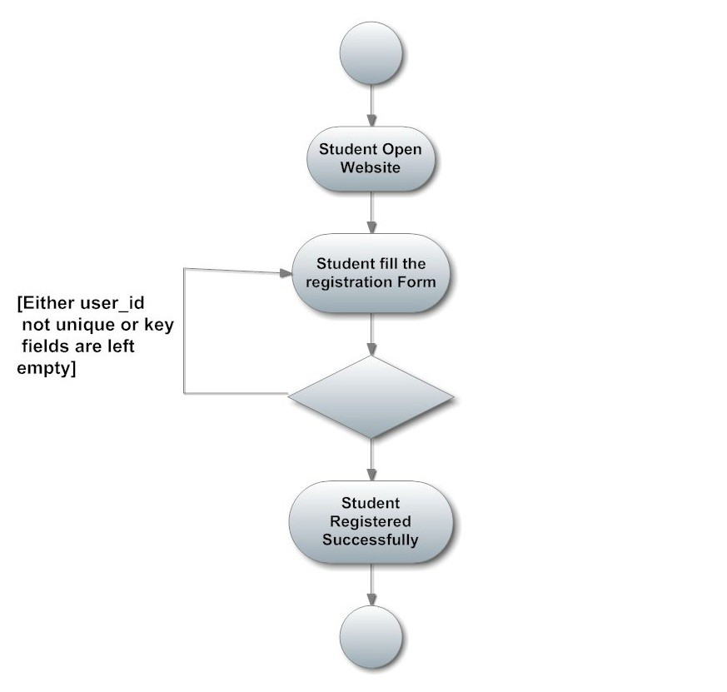
Resume
Image
The System details are added to the database.
The student details are displayed on the screen.
Alternative Flow:
User ID not unique: if the user id entered is not unique then it will show an error message.
Post conditions:
The student get registered on the website and to login into that particular the administrator must enable it.

Slide 19
Use-case: Login into the website
Goal in context: Gain access to the website
Brief Description: This use case is used when the student wants to access the website.
Preconditions: The Administrator must enabled the particular student onto the website in order for this use case to begin.
Basic Flow:
The website prompts the student for the user name and password.
The Student enters the user name and password.
The website verifies the password and sets the user’s authorization.
The Student is given access to the website to perform his tasks.
Alternative Flow:
The Student enters invalid username and password then he will not be allowed to enter the website.
Post conditions: The website state is unchanged by this use case.

Slide 20
Use Case : Edit student details
Goal in context: Edit the details of a student
Brief Description : This use case is used when the student wants to edit the personal details of the himself/herself already existing in the database.
Preconditions:
The Student must be logged into the system in order for this use case
to begin.
The details of the student must pre-exist in the database
The student must be enabled by administrator.
Basic Flow:
The Student logs onto the System.
The Student can edit following keys:-
First/last name
Gender
DOB
Contact no
Qualification
City
Email1
Email2
Address
Description

Slide 21
The Website updates the database according to edited details.
The student details are edited in the database.
Alternative Flow:
There is no alternative flow of this use case diagram.
Post conditions:
The student details get updated in the database.

Slide 22
Functional Requirements :
The Administrator will be given more powers (enable/disable/ update) than other users.
It will be ensured that the information entered is of the correct format. For example name cannot contain numbers. In case if incorrect form of information is added, the user will be asked to fill the information again.
The system can be accessed anytime
Non- Functional Requirement :
Performance Requirements : The proposed system that we are going to develop will be used as the Chief performance system for providing help to the organization in managing the whole database of the student studying in the organisation. Therefore, it is expected that the database would perform functionally all the requirements that are specified.
Safety Requirements : The database may get crashed at any certain time due to virus or operating system failure. Therefore, it is required to take the database backup

Slide 23
3. Security Requirements : We are going to develop a secured database. There are different categories of users namely Administrator ,Student who will be viewing either all or some specific information form the database. Depending upon the category of user the access rights are decided. It means if the user is an administrator then he can be able to modify the data, append etc. All other users only have the rights to retrieve the information about database.
Conclusion :
This SRS has given all the details of the application need to be built.

Slide 24
DESIGN PHASE
Introduction
Scope and purpose
The purpose of the design phase is to develop a clear understanding of what the developer want people to gain from his/her project. As you the developer work on the project, the test for every design decision should be "Does this feature fulfill the ultimate purpose of the project?“
A purpose statement affects the design process by explaining what the developer wants the project to do, rather than describing the project itself.
The Design Document will verify that the current design meets all of the explicit requirements contained in the system model as well as the implicit requirements desired by the customer.
2. Overall System Design Objectives
The overall system design objective is to provide an efficient, modular design that will reduce the system’s complexity, facilitate change and result in an easy implementation. This will be accomplished by designing strongly cohesion system with minimal coupling. In addition, this document will provide interface design models that are consistent user friendly and will provide straight forward transition through the various system functions.

Slide 25
Structure of Design Document
System Architecture Design – The System architecture section has detailed diagram of the system, server and client architecture. ▪ Data Design – The data Design include an ERD as well as Database design. ▪ Functional Design Description – This section has the functional partitioning from the SRS, and goes into great detail to describe each function.
System Architecture Design
System Architecture
The SIMS is a system which contain major part which include: student Detail, Student image and resume. The user selects one of the available options as an input to the system. According to the input by the user the system acts and the rest of the functions are performed accordingly.The administrator can operate on any student details. But the normal student or users can only access their details of all the functionalities.

Slide 26
Student Information
System
Online Registration of
Student
Search Student
Details
Maintaining Student
Details
Architecture Diagram
Data Design
1. Entity Relationship Diagram :

Slide 27
Login - id
Administrator
Password
Manages
address
resume
email
Description
Last login
date
Student id
city
Student
password
Student
qualifiation
First name
Contact no
Last name
image
Registration
date
gender
Date of
birth
Student
status
Entity Relationship Diagram

Slide 28
Context Level DFD (0 level)
Request for Login
Response
0.0
Student Management
system
ADMIN
0 Level DFD for student management
system project
The 0 level DFD known as context level data flow diagram. The context level data flow diagram (DFD) is describe the whole system. The (o) level DFD describe the all user modules who run the system. Below context level data flow diagram of Student management system project shows the one Admin user can operate the system. Admin do all activities after login to system.
The Admin side DFD describe the functionality of Admin. Admin is a responsible person who run the project. After login to system admin can first Add Course Detail and Teacher Detail and then add student detail by course wise. and admin can manage student reports and fees payment detail.

Slide 29
1st Level Admin Side DFD(1.0)
Request for Login
Response
1.0
Login
Check for Login
Reply
AdminMst
ADMIN
Add Course
Response
1.1
Add Course
Insert Data
Reply
StudentMst
Add Teacher
Response
1.2
Add Teacher
Insert Data
Reply
FeesMst
Add Student
Response
1.3
Add Student
Insert Data
Reply
StudentMst
View Report
Display Data
1.5
Search Report
Send Data
Reply
StudentMst
Manage Student & Admin user
Response
1.6
Admin Activity
Send Data
Reply
StudentMst ,
AdminMst

Slide 30
2nd level Admin Side DFD(2.0)
Request for Login
Response
2.0
Login
Check for Login
Reply
ADMIN
AdminMst
2.1
Add Student
Insert Data
Reply
StudentMst
Add Fees
Response
2.2
Add Fees
Update fees
Reply
FeesMst
Send Data
Response
2.3
Edit Student Detail
Update Data
Reply
StudentMst

Slide 31
2nd level Admin Side DFD End (3.0)
Request for Login
Response
3.0
Login
Check for Login
Reply
AdminMst
ADMIN
Send StudentID
Response
3.1
Delete Student
Delete Data
Reply
StudentMst
Send CourseID
Response
3.2
Delete Course
Delete Data
Reply
CourseMst
Send TeacherID
Response
3.3
Delete Teacher
Delete Data
Reply
TeacherMst
Add User Details
Response
3.4
Add / Delete
Login user
Insert / Delete Data
Reply
LoginMst

Slide 32
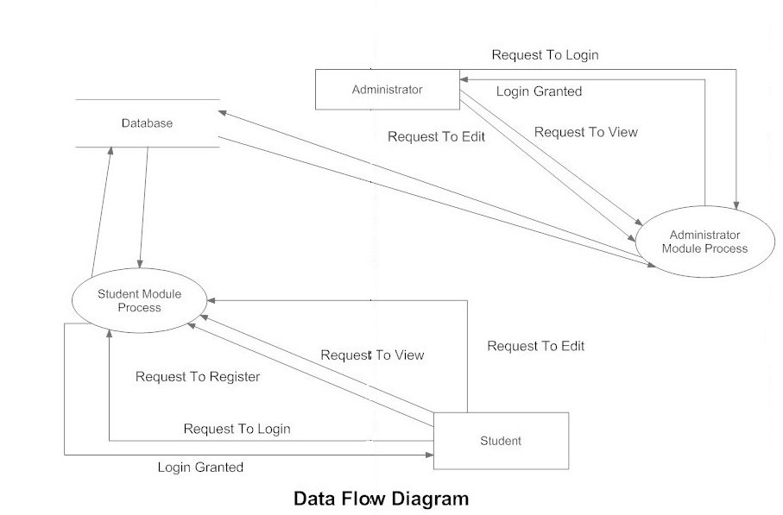
Functional Design Description :-
Administrator
Database
Administrator Module
Process
Student
Module
Process
Overall DFD

Slide 33
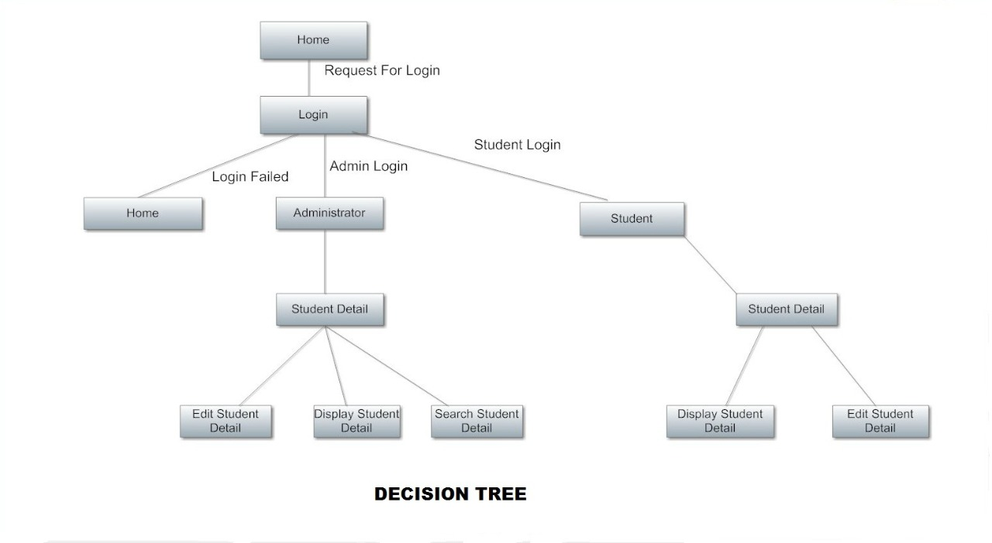
2. Decision Tree :

Slide 34
Conclusion
Hence we can conclude that the design phase of the SIMS give us the information of all the processes used in the project and their relation.
TECHNOLOGY OVERVIEW
The technology selected for implementing Student Information Management System is PHP/MYSQL. Apache is used as the HTTP server . The development was done in a ‘windows’ environment using adobe dreamweaver CS5.
PHP
PHP is a general-purpose scripting language that is especially suited to server side web development where PHP generally runs on a web server.PHP code is embedded into the HTML source document . Any PHP code in a requested file is executed by the PHP runtime, usually to create dynamic web page content . It can also be used for command-line scripting and client-side GUI applications. PHP can be deployed on many web servers and operating systems, and can be used with many relational database management systems.

Slide 35
It is available free of charge, and the PHP Group provides the complete source code for users to build, customize and extend for their own use.
MySQL
MySQL is a relational database management system (RDBMS)[1] that runs as a server providing multi-user access to a number of databases. MySQL is a popular choice of database for use in web applications and is an open source product. The process of setting up a MySQL database varies from host to host, however we will end up with a database name, a user name and a password. Before using our database, we must create a table.
A table is a section of the database for storing related information. In a table we will set up the different fields which will be used in that table. Creating a table in phpMyAdmin is simple, we just type the name, select the number of fields and click the ‘go’ button. we will then be taken to a setup screen where you must create the fields for the database . Another way of creating databases and tables in phpMyAdmin is by executing simple SQL statements . We have used this method in order to create our database and tables.

Slide 36
Apache
The Apache HTTP Server is a web server software notable for playing a key role in the initial growth of the World Wide Web. In 2009 it became the first web server software to surpass the 100 million web site milestone. Apache is developed and maintained by an open community of developers under the auspices of the Apache Software Foundation. Since April 1996 Apache has been the most popular HTTP server software in use. As of November 2010 Apache served over 59.36% of all websites and over 66.56% of the first one million busiest websites.
XAMPP
XAMPP is a small and light Apache distribution containing the most common web development technologies in a single package. Its contents, small size, and portability make it the ideal tool for students developing and testing applications in PHP and MySQL. XAMPP is available as a free download in two specific packages: full and lite . While the full package download provides a wide array of development tools, XAMPP Lite contains the necessary technologies that meet the Ontario Skills Competition standards .The light version is a small package containing Apache HTTP Server, PHP, MySQL, phpMyAdmin, Openssl , and SQLite .

Slide 37
Obtaining and Installing XAMPP
As previously mentioned, XAMPP is a free package available for download and use for various web development tasks. All XAMPP packages and add-ons are distributed through the Apache Friends website at the address: http://www.apachefriends.org/. Once on the website, navigate and find the Windows version of XAMPP and download the self-extracting ZIP archive. After downloading the archive, run and extract its contents into the root path of a hard disk or USB drive. For example, the extract path for a local Windows installation would simply be C:\. If extracted properly we will notice a new xampp directory in the root of your installation disk. In order to test that everything has been installed correctly, first start the Apache HTTP Server by navigating to the xampp directory and clicking on the apache_start.bat batch file.
Next we will test if the server is running correctly by opening an internet browser and typing http://localhost/ into the address bar. If configured correctly, we will be presented with a screen similar to that of the one below.

Slide 38
distributed through the Apache Friends website at the address:
http://www.apachefriends.org/
Once on the website, navigate and find the Windows
version of XAMPP and download the self-extracting ZIP archive.
After downloading the archive, run and extract its contents into the root path of a hard disk or USB drive.
For example, the extract path for a local windows installation would simply be C:\ .
If extracted properly we will notice a new xampp directory in the root of your installation disk.
In order to test that everything has been installed correctly, first start the apache http server by navigating to the xamp directory and clicking on the apache_start.Bat batch file.
Next we will test if the server is running correctly by opening an internet browser and typing http://localhost/ into the address bar.
If configured correctly, we will be presented with a screen similar to that of the one below

Slide 39

XAMPP splash screen
In order to stop all Apache processes we do not close the running terminal
application, but instead run another batch file in the xampp lite directory called apache_stop.bat.
Creating a Database and Inserting Data
Now that we have run and tested Apache and PHP, the next step is running MySQL and creating a database and table which will hold information to be used by our website.

Slide 40
In order to start mysql, navigate to the xampp directory and run the mysql_start.Bat batch file.
The xampp package contains an application called
Php my admin which allows developers to administer and maintain mysql databases.
We will be using phpmyadmin to create a database and table and enter test data.
Before testing phpmyadmin, make sure that both apache and mysql are running by opening their respective batch files: apache_start.Bat and
Mysql_start_bat.
Along with apache and mysql running in the background, we type http://localhost/phpmyadmin/ into our web browser.
If successful we will be presented with a phpmyadmin start page similar to the one shown below.

Slide 41
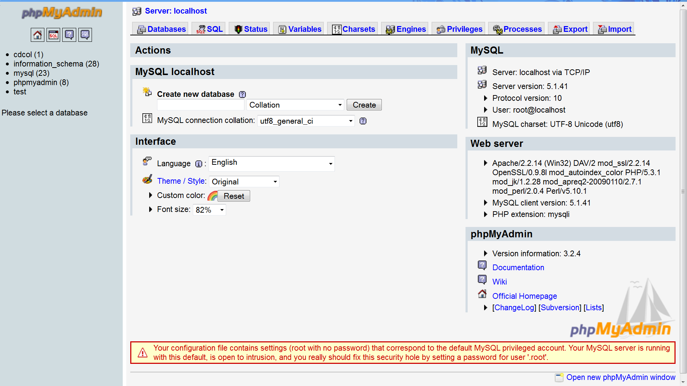
The first step with phpMyAdmin running is creating a new database.We create a new database by directly executing SQL statements as shown below.The successful execution of the sql querry creates a database ‘student’ with two tables in it.The tabels
are admin_login and student_information.We also inserted values in the admin table.
The screenshot below shows the successful execution of the query thus creation of a database named student.

Slide 42
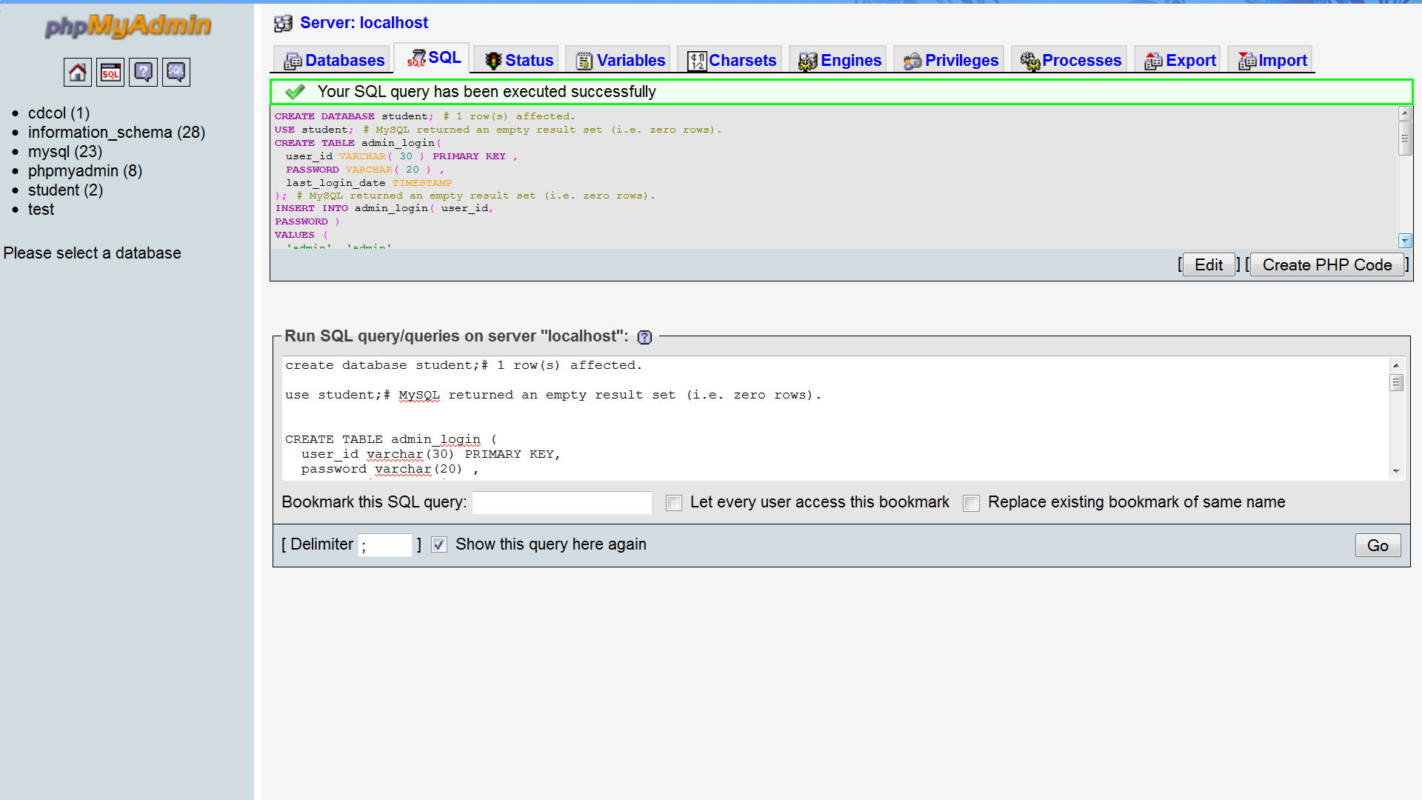
Creation of database in mysql using phpMyadmin
Thus we have learned to create a database in MYSQL by executing sql statements. After creating the database and tables we are now ready to use them in our website “Student Information Management System”.

Slide 43
PROJECT DESCRIPTION
Introduction
Student Information Management System can be used by education institutes to
maintain the records of students easily. Achieving this objective is difficult using a
manual system as the information is scattered, can be redundant and collecting
relevant information may be very time consuming. All these problems are solved
using this project
The directory structure of the project is as follows:

Slide 44
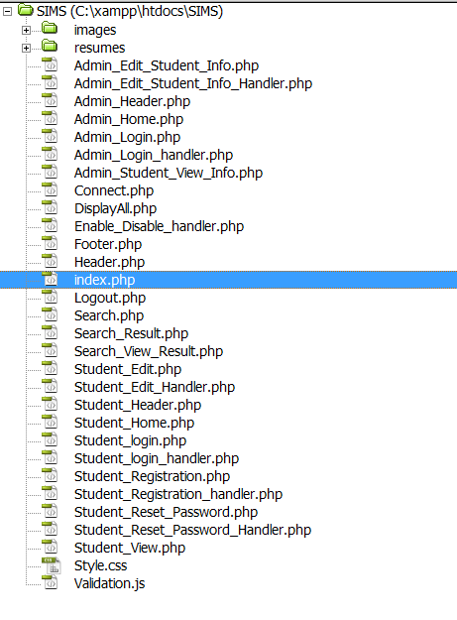

Slide 45
Description of root directory contents
Images Directory : This directory contains the images uploaded by the students during registration process.Supported formats are the .jpg and .gif
files.
Resume Directory : This Directory Contains resumes of students uploaded during registration process of students.Files in this folder can be of .doc, .txt or .pdf format.
Admin_Edit_Student_Info.php : Admin page for editing information of a student.The administrator can change details of a student in this page.Though
facility of changing the image and resume are not yet provided but will be provided in future versions of the project.
Admin_Edit_Student_Info_Handler.php : Page handler for handlingtheAdmin_Edit_Student_Info.
php file.It writes the edited values in the database
on the server.
Admin_Header.php : Header file for pages accessible to administrator only.
Admin_Home.php : Home page for administrator
after logging in process.
.

Slide 46
Admin_Login.php : Login page for administrator access.Shows appropriate message for wrong username and/or password.
Admin_Login_handler.php : Page handler for Admin_Login.php page.It checks the values provided with the values in the database.
Admin_Student_View_Info.php : Page to display student information to the administrator.
Connect.php : Page for database connectivity.It is used whenever database values are required on the page.
DisplayAll.php : Page to display all registered students to the administrator.This facility is only available to the administrator.
Enable_Disable_handler.php : Handler page for enabling/disabling of students account facility.This functionality is only available to the administrator.
Footer.php : Footer file for all pages.
Header.php : Header file for login page and homepage of the site.
Index.php : Homepage of the website.

Slide 47
Logout.php : Logout handler page.It Destroys all session variables thus ending user session.
Search.php : Search page to search students.It can only be used by administrator.Students can be searched using different fields such as user id,
account status etc.
Search_Result.php : Page to display search results to the administrator.
Search_View_Result.php : Page to display student information for any selected search result.
Student_Edit.php : Page to edit student information.It can be accessed by students.
Student_Edit_Handler.php : Page handler for Student_Edit.php.
Student_Header.php : Header file for student pages.
Student_Home.php : Home page for students after they log into their respective accounts.
Student_login.php : Login Page for student login.
Appropriate message is displayed if the login is
unsuccessful.

Slide 48
Student_login_handler.php : Page handler for Student_Login.php.It checks the values provided with that in th the database.
Student_Registration.php : Student Registration page.The students enters various details here for registration.
Student_Registration_handler.php : Page Handler for handling the file Student_registration.php.It adds value to the student_information table thus
creating a new user.
Student_Reset_Password.php : Page for resetting password.It can be used only bystudents.
Administrator password can be changed only by changing the values in the table directly.
Student_Reset_Password_Handler.php : Page handler for handling page Student_Reset_Password.php.
Student_View.php : Page to display student profile with all the details of the student.
Style.css : Stylesheet for the whole site design.
Validation.js : Javascript validations used for
validation of form values. Various form entries are
validated at the client side using this file only.
.

Slide 49
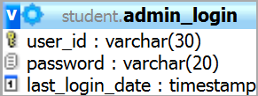
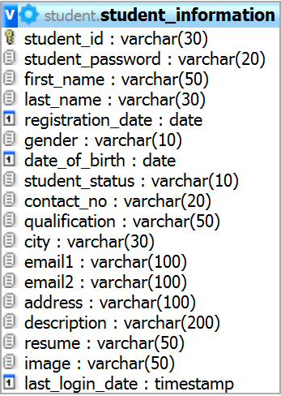
Description of database tables
admin_login :
user_id : Stores user id of administrator(s).
password : Stores password of the administrator(s).
last_login_date : Stores the last login date of the administrator(s).
Student_information :

Slide 50
student_id : Stores user id of the student(s)
student_password : Stores password of the
student(s)
first_name : Stores first name of the student(s)
last_name : Stores last name of the student(s)
registration_date : Stores the registration date of the student(s).
gender : Stores the gender of the student(s)
date_of_birth : Stores the date of birth of the student(s).
student_status : Stores the current status of the student account(s).
contact_no : Stores the contact number of the student(s).
qualification : Stores student(s) qualification.
city : Stores the city in which the student(s) lives.
email1 : Stores primary email of the student(s).
email2 : Stores secondary email of the student(s).
address : Stores the address of the student(s).
description : Stores description of the student(s).
resume : Stores resume of students(s).
image : Stores image of the student(s).
last_login_date : Strores last login date of the
student(s).

Slide 51
Features Of Our Project
The Website provides following functionalities to the users :
Administrator :
Login/Logout
View student information
Edit Student Information
Enable/disable student accounts
Search students
Student :
Login/Logout
View profile
Edit profile
Change password
Register new profile

Slide 52
Source Code
<html>
<head>
<meta http-equiv="Content-Type" content="text/html; charset=iso-8859-1">
<link rel="stylesheet" href="Style.css" type="text/css"/>
<title>Home Page</title>
</head><body>
<table width="100%" height="100%" >
<tr height="15%">
<td><?php include 'Header.php';?></td>
</tr>
<tr height="80%">
<td align="center" valign="baseline"><table width="70%"> <tr height="10%">
<td align="center"><a href="index.php" class="stylelink" style="textdecoration:none">Home</a></td>
<td align="right"><a href="Student_login.php" class="stylelink"
style="text-decoration:none">Student Login</a>
&nbsp;&nbsp;&nbsp;&nbsp;&nbsp;&nbsp;&nbsp;&nbsp;&nbsp;&nbsp;&nbsp;
<a href="Admin_login.php" class="stylelink" style="textdecoration:none">Administrator Login</a></td>
</tr><tr>
<td>&nbsp;</td>
<td>&nbsp;</td>

Slide 53
</tr>
<tr>
<td>&nbsp;</td>
<td>&nbsp;</td>
</tr>
</table></td>
</tr>
<tr height="5%">
<td><?php include 'Footer.php';?></td>
</tr>
</table>
</body>
</html>
Student_login.php
<html>
<head>
<meta http-equiv="Content-Type" content="text/html; charset=iso-8859-1">
<title>Login Page</title>
<link rel="stylesheet" href="Style.css" type="text/css"/>
<script type="text/javascript">
function validate()
{
if(document.form1.st_id.value=="")
{
alert("Please enter your login Id.");

Slide 54
document.form1.st_id.focus();
return false;
}
if(document.form1.st_pass.value=="")
{
alert("Please enter your password.");
document.form1.st_pass.focus();
return false;
} }
</script>
</head>
<body onLoad="javascript:document.form1.st_id.focus()">
<form name="form1" method="post" action="Student_login_handler.php"
onSubmit="return validate();">
<table width="100%" height="100%" >
<tr>
<td height="15%"><?php include 'Header.php';?></td>
</tr>
<tr>
<td width="100%" height="80%" align="center" valign="baseline"><table
width="90%" >
<tr>
<td width="8%"><a href="index.php" class="stylelink" style="textdecoration:none; font-family: &quot;Times New Roman&quot;, Times,
serif;">Home</a></td>

Slide 55
<td width="35%" align="center">&nbsp;</td>
<td width="27%">&nbsp;</td>
<td width="30%" align="right"><a href="Student_Registration.php"
class="stylelink" style="text-decoration:none ; font-weight: bold;">New
Student Click Here</a></td>
</tr>
<tr>
<td>&nbsp;</td>
<td>&nbsp;</td>
<td>&nbsp;</td>
<td>&nbsp;</td>
</tr>
<tr>
<td>&nbsp;</td>
<td>&nbsp;</td>
<td>&nbsp;</td>
<td>&nbsp;</td>
</tr>
<?php if($_GET['flag'] == "success") { ?>
<tr>
<td class="stylegreen" colspan="4"
align="center">Congratulations! You Are successfully registered. You can use
your Login Id and Password to login to your account.</td>
</tr>

Slide 56
<?php
}
else if($_GET['flag'] == "exists") { ?>
<tr>
<td class="stylered" colspan="4" align="center">This Login
Id( <?=$_GET['student_id']?>) already exists.Please, try again with another
Login Id</td>
</tr>
<?php
}else if($_GET['flag'] == "error") {
?>
<tr>
<td class="stylered" colspan="4" align="center">Error while
inserting data. Please, try again.</td>
</tr>
<?php
}
?>
<tr>
<td>&nbsp;</td>
<td>&nbsp;</td>
<td>&nbsp;</td>
<td>&nbsp;</td>
</tr>
<tr>

Slide 57
<td>&nbsp;</td>
<td>&nbsp;</td>
<td>&nbsp;</td>
<td>&nbsp;</td>
</tr>
<tr>
<td colspan="4"><table width="30%" border="1" align="center"
cellpadding="3" cellspacing="0" bordercolor="#CCCCCC"
bgcolor="#CCCCCC">
<tr align="center" bgcolor="#999999">
<td colspan="2" class="stylebig">Student Login Here</td>
</tr>
<tr bgcolor="#E1E1E1" class="stylesmall">
<td width="35%" align="left" class="style7">Login Id : </td>
<td width="65%" align="left"><input name="st_id" type="text"
id="st_id"></td>
</tr>
<tr bgcolor="#E1E1E1" class="stylesmall">
<td align="left" class="style7">Password:</td>
<td align="left"><input name="st_pass" type="password"
id="st_pass"></td>
</tr>
<tr bgcolor="#E1E1E1">
<td colspan="2" align="center">&nbsp;
<?php if($_GET['flag'] == "invalid") { ?>

Slide 58
<span class="stylered">Invalid Login Id or Password</span>
<?php }?>
</td>
</tr>
<tr bgcolor="#E1E1E1">
<td colspan="2" align="center"><input name="login" class="style10"
type="submit" id="login" value="Login">
<input name="close" type="button" id="close" class="style10"
value="Close" onClick="self.location='index.php'"> </td>
</tr>
</table></td>
</tr>
</table></td>
</tr>
<tr>
<td height="5%" align="center"><?php include 'Footer.php';?></td>
</tr>
</table>
</form>
</body>
</html>
Student_login_handler.php
<?php
session_start();
include 'Connect.php';

Slide 59
$flag = "";
$student_id = $_POST['st_id'];
$st_pass = $_POST['st_pass'];
$query = "select last_login_date from student_information where
student_id='$student_id' and student_password='$st_pass' and
student_status ='Enable'";
$result = mysql_query($query,$link_id);
if(mysql_error() != null){
die(mysql_error());
}
if($date = mysql_fetch_array($result))
{
$lastdate = $date['last_login_date'];
$date2 = date("d-m-Y h:i A",strtotime($lastdate));
$_SESSION['userid'] = $_POST['st_id'];
$_SESSION['lastlogin'] =$date2;
$_SESSION['type'] = "Student";
mysql_query("update student_information set
last_login_date=now() where student_id='$student_id'",$link_id);
if(mysql_error() != null){
die(mysql_error());
}
header("location:Student_Home.php");
die();
}

Slide 60
else
{
$flag = "invalid";
header("location:Student_login.php?flag=$flag");
die();
}
?>
Student_Registration.php
<html>
<head>
<link rel="stylesheet" href="Style.css" type="text/css"/>
<meta http-equiv="Content-Type" content="text/html; charset=iso-8859-1">
<title>Student Registration Page</title>
<script src="Validation.js"></script>
<script type="text/javascript">
function validation()
{
if(document.form1.first_name.value=="")
{
alert("Please enter your first name.");
document.form1.first_name.focus();
return false;
}
if(document.form1.last_name.value=="")
{

Slide 61
alert("Please enter your last name.");
document.form1.last_name.focus();
return false;
}
if(document.form1.dob.value=="")
{
alert("Please enter your date of birth.");
document.form1.dob.focus();
return false;
}
else
{
var date = document.form1.dob.value;
var yes = checkDate(date);
if(!yes)
{
alert("Please Enter a valid date of birth.");
document.form1.dob.focus();
return false;
}
}
if(document.form1.email1.value=="")
{
alert("Please enter your primary email.");
document.form1.email1.focus();

Slide 62
return false;
}
else
{
var isEmail = emailValidator(document.form1.email1.value);
if(!isEmail)
{
alert("Please enter a valid primary email.");
document.form1.email1.focus();
return false;
}
}
if(document.form1.address.value != "" &&
document.form1.address.value.length > 100){
alert("You can enter address upto 100 characters only.");
document.form1.address.focus();
return false;
}
if(document.form1.description.value != "" &&
document.form1.description.value.length > 200){
alert("You can enter description upto 200 characters only.");
document.form1.description.focus();
return false;
}
if(document.form1.st_id.value=="")

Slide 63
{
alert("Please enter your desired student id.");
document.form1.st_id.focus();
return false;
}
if(document.form1.st_pass.value=="")
{
alert("Please enter your desired password.");
document.form1.st_pass.focus();
return false;
}
if(document.form1.retype.value=="")
{
alert("Please enter retype password.");
document.form1.retype.focus();
return false;
}
if(document.form1.st_pass.value != document.form1.retype.value)
{
alert("Password and retype password are not same.");
document.form1.st_pass.value = "";
document.form1.retype.value = "";
document.form1.st_pass.focus();
return false;
}

Slide 64
}
</script>
</head>
<body onLoad="javascript:document.form1.first_name.focus()">
<form name="form1" method="post"
action="Student_Registration_handler.php" onSubmit="return validation()"
enctype="multipart/form-data">
<table width="100%">
<tr>
<td width="100%" height="15%" align="center"><?php include
'Header.php';?></td>
</tr>
<tr>
<td width="100%" height="80%" align="center"><table width="80%"
border="1" cellpadding="2" cellspacing="0" bordercolor="#CCCCCC">
<tr bgcolor="#EEEEEE">
<td colspan="4" align="center" class="stylemedium">Student
Information</td>
</tr>
<tr class="stylesmall">

Slide 65
<td>First Name <span class="stylered">*</span> </td>
<td><input name="first_name" type="text" id="first_name"
maxlength="50"></td>
<td>Last Name <span class="stylered">*</span> </td>
<td><input name="last_name" type="text" id="last_name"
maxlength="30"></td>
</tr>
<tr class="stylesmall">
<td>Gender</td>
<td><input name="gender" type="radio" value="Male" checked>
Male<input name="gender" type="radio" value="Female">
Female</td>
<td>Date Of Birth <span class="stylered">*</span> </td>
<td><input name="dob" type="text" id="dob" size="10"
maxlength="10">
DD-MM-YYYY</td>
</tr>
<tr class="stylesmall">
<td>Qualification <span class="stylered">*</span> </td>
<td><select name="qualification" id="qualification">
<option value="">-----select-----</option>
<option value="High School">High School</option>
<option value="Graduate">Graduate</option>
<option value="MCA">MCA</option>
<option value="BCA">BCA</option>

Slide 66
<option value="Master Degree">Master Degree</option>
</select></td>
<td>Contact No</td>
<td><input name="contact_no" type="text" id="contact_no"
maxlength="20"></td>
</tr>
<tr class="stylesmall">
<td> City</td>
<td><input name="city" type="text" id="city" maxlength="30"></td>
<td>&nbsp;</td>
<td>&nbsp;</td>
</tr>
<tr class="stylesmall">
<td>Primary Email <span class="stylered">*</span> </td>
<td><input name="email1" type="text" id="email1"
maxlength="100"></td>
<td>Secondary Email</td>
<td><input name="email2" type="text" id="email2"
maxlength="100"></td>
</tr>
<tr class="stylesmall">
<td>Address</td>
<td colspan="3"><textarea name="address" cols="45" rows="2"
id="address"></textarea></td>

Slide 67
</tr>
<tr class="stylesmall">
<td> Description</td>
<td colspan="3"><textarea name="description" cols="45" rows="3"
id="description"></textarea></td>
</tr>
<tr bgcolor="#EEEEEE">
<td colspan="4" align="center" class="stylemedium">Login
Information</td>
</tr>
<tr>
<td colspan="4">&nbsp;</td>
</tr>
<tr class="stylesmall">
<td>Desired ID <span class="stylered">*</span> </td>
<td><input name="st_id" type="text" id="st_id" maxlength="20"></td>
<td>&nbsp;</td>
<td>&nbsp;</td>
</tr>
<tr class="stylesmall">
<td>Password <span class="stylered">*</span> </td>
<td><input name="st_pass" type="password" id="st_pass"
maxlength="20"></td>
<td align="right">Retype Password<span class="stylered"> *</span>
</td>

Slide 68
<td><input name="retype" type="password" id="retype"
maxlength="20"></td>
</tr>
<tr>
<td>&nbsp;</td>
<td>&nbsp;</td>
<td>&nbsp;</td>
<td>&nbsp;</td>
</tr>
<tr bgcolor="#EEEEEE">
<td colspan="4" align="center" class="stylemedium"> Resume
Information</td>
</tr>
<tr class="stylesmall">
<td>Upload Resume </td>
<td colspan="3"><input name="resume" type="file" >
&nbsp;&nbsp;&nbsp;&nbsp;&nbsp;&nbsp;&nbsp;&nbsp;<span
class="stylered">.doc , .txt, .pdf file only</span></td>
</tr>
<tr>
<td colspan="4">&nbsp;</td>
</tr>
<tr align="center" class="stylemedium" bgcolor="#EEEEEE">
<td colspan="4">Image Information</td>
</tr>

Slide 69
<tr class="stylesmall">
<td>Upload Image </td>
<td colspan="3"><input type="file" name="image">
&nbsp;&nbsp;&nbsp;&nbsp;&nbsp;&nbsp;&nbsp;&nbsp;<span
class="stylered"><span class="stylered">.jpg file And .gif file
only</span></td>
</tr>
<tr>
<td colspan="4"><span class="stylered">* <em>means fields are
compulsory</em> </span></td>
</tr>
<tr>
<td colspan="4" align="center"><input name="register" type="submit"
id="register" value="Register">
<input name="reset" type="reset" id="reset" value="Reset">
<input name="close" type="button" id="close" value="Close"
onClick="self.location='Student_login.php'"></td>
</tr>
</table></td>
</tr>
<tr>
<td width="100%" height="5%" align="center"><?php include
'Footer.php';?></td>
</tr>
</table>

Slide 70
</form>
</body>
</html>
Student_Registration_handler.php
<?php
include 'Connect.php';
$flag = "success";
function rollbackData(){
mysql_query(" ROLLBACK ");
global $flag;
$flag = "error";
if(mysql_error() != null){
die(mysql_error());
}
}
$student_id = $_POST['st_id'];
$student_pass = $_POST['st_pass'];
$first_name = $_POST['first_name'];
$last_name = $_POST['last_name'];
$gender = $_POST['gender'];
$contact_no = $_POST['contact_no'];
$qualification = $_POST['qualification'];
$city = $_POST['city'];
$email1 = $_POST['email1'];
$email2 = $_POST['email2'];

Slide 71
$address = $_POST['address'];
$description = $_POST['description'];
$resumename = "";
$imagename = "";
$dobdate = date("Y-m-d",strtotime($_POST['dob']));
/*
This block is used to check whether the student_id already exits
in database.
*/
$select_query="select student_id from student_information where
student_id = '$student_id'";
$result_set = mysql_query($select_query,$link_id);
if($row = mysql_fetch_array($result_set)){
$flag="exists";
header("location:Student_login.php?
flag=$flag&student_id=$student_id");
die();
}
else{
/*
This block is used to insert the student record in database
if the student_id is already not present in the database.
*/
mysql_query("SET AUTOCOMMIT = 0 ");
if(mysql_error() != null){

Slide 72
die(mysql_error());
}
$query = "insert into
student_information(student_id,student_password,first_name,last_name,regis
tration_date,gender,date_of_birth,";
$query .=
"student_status,contact_no,qualification,city,email1,email2,address,descriptio
n)";
$query .= "
values('$student_id','$student_pass','$first_name','$last_name',now(),'$gender
','$dobdate','Disable','$contact_no',";
$query .=
"'$qualification','$city','$email1','$email2','$address','$description')";
$result = mysql_query($query,$link_id);
if(mysql_error() != null){
die(mysql_error());
}
if($result){
if($_FILES['resume']['name'] != ""){
$filename = $_FILES['resume']['name'];
$ext = strrchr($filename,".");
$resumename = $student_id;
$resumename .= "_".$filename;
if($ext ==".txt" || $ext ==".doc" || $ext ==".TXT" ||
$ext ==".DOC" || $ext ==".pdf" || $ext ==".PDF"){

Slide 73
$size = $_FILES['resume']['size'];
if($size > 0 && $size < 1000000){
$archive_dir = "resumes";
$userfile_tmp_name =
$_FILES['resume']['tmp_name'];
if(move_uploaded_file($userfile_tmp_name, "$archive_dir/
$resumename")){
/*
if image is successfully
uploaded then resumename is stored in database.
*/
mysql_query("update
student_information set resume='$resumename' where
student_id='$student_id'", $link_id);
if(mysql_error() != null){
die(mysql_error());
}
$flag = "success";
}else{
rollbackData();
}
}
else{
rollbackData();
die("You can upload resume of 1 MB

Slide 74
size only. Please, try again.");
}
}
else{
rollbackData();
die("You can upload resume of .txt, .pdf,
.doc extensions only. Please, try again.");
}
}
if($_FILES['image']['name'] != ""){
$filename = $_FILES['image']['name'];
$ext = strrchr($filename,".");
$imagename = $student_id;
$imagename .="_". $filename;
if($ext ==".jpg" || $ext ==".jpeg" || $ext ==".JPG" ||
$ext ==".JPEG" || $ext ==".gif" || $ext ==".GIF"){
$size = $_FILES['image']['size'];
if($size > 0 && $size < 1000000){
$archive_dir = "images";
$userfile_tmp_name =
$_FILES['image']['tmp_name'];
if(move_uploaded_file($userfile_tmp_name, "$archive_dir/
$imagename")){
/*
if image is successfully

Slide 75
uploaded then imagename is stored in database.
*/
mysql_query("update
student_information set image='$imagename' where
student_id='$student_id'", $link_id);
$flag = "success";
if(mysql_error()!=null){
die(mysql_error());
}
}
else{
if(file_exists('resumes/' .
$resumename)) {
unlink('resumes/' .
$resumename);
}
rollbackData();
}
}
else{
if(file_exists('resumes/' .
$resumename)) {
unlink('resumes/' .
$resumename);
}

Slide 76
rollbackData();
die("You can upload image of 1 MB
size only. Please, try again.");
}
}
else{
if(file_exists('resumes/' . $resumename)) {
unlink('resumes/' . $resumename);
}
rollbackData();
die("You can upload images of .jpg, .jpeg,
.gif extensions only. Please, try again. ");
}
}
}
else{
$flag="error";
}
if($flag == "success"){
mysql_query(" COMMIT ");
$flag="success";
if(mysql_error() != null){
die(mysql_error());
}
/*

Slide 77
This block is used to send email to the
successfully registered users.
*/
/*
$to = $email1;
$subject = 'Congratulations';
$message = 'Congratulations you are registered in our
site.\r\n\r\n';
$message .= "Your Login Id : $student_id \r\n Password :
$student_pass";
$headers = "From: info@sims.com\r\n";
$headers .= 'X-Mailer: PHP' . phpversion();
mail($to, $subject, $message, $headers);
*/
}
header("location:Student_login.php?flag=$flag");
die();
}
?>
Admin_Edit_Student_Info.php
<?php
session_start();
$session_id = $_SESSION['userid'];
if($session_id == null){
header("location:index.php");

Slide 78
die();
}
include 'Connect.php';
$student_id = $_REQUEST['student_id'];
$query = "select * from student_information where
student_id='$student_id'";
$result = mysql_query($query, $link_id);
$data = mysql_fetch_array($result);
?>
<html>
<head>
<link rel="stylesheet" href="Style.css" type="text/css"/>
<meta http-equiv="Content-Type" content="text/html; charset=iso-8859-1">
<title>Edit Student Information By Admin</title>
<script src="Validation.js"></script>
<script type="text/javascript">
function validation()
{
if(document.form1.first_name.value=="")
{
alert("Please enter your first name.");
document.form1.first_name.focus();
return false;
}

Slide 79
if(document.form1.last_name.value=="")
{
alert("Please enter your last name.");
document.form1.last_name.focus();
return false;
}
if(document.form1.dob.value=="")
{
alert("Please enter your date of birth.");
document.form1.dob.focus();
return false;
}
else
{
var date = document.form1.dob.value;
var yes = checkDate(date);
if(!yes)
{
alert("Please Enter a valid date of birth.");
document.form1.dob.focus();
return false;
}
}
if(document.form1.email1.value=="")
{

Slide 80
alert("Please enter your primary email.");
document.form1.email1.focus();
return false;
}
else
{
var isEmail = emailValidator(document.form1.email1.value);
if(!isEmail)
{
alert("Please enter a valid primary email.");
document.form1.email1.focus();
return false;
}
}
if(document.form1.email2.value != "")
{
var isEmail = emailValidator(document.form1.email2.value);
if(!isEmail)
{
alert("Please enter a valid secondary email.");
document.form1.email2.focus();
return false;
}
}
if(document.form1.address.value != "" &&

Slide 81
document.form1.address.value.length > 100){
alert("You can enter address upto 100 characters only.")
document.form1.address.focus();
return false;
}
if(document.form1.description.value != "" &&
document.form1.description.value.length > 200){
alert("You can enter description upto 200 characters only.")
document.form1.description.focus();
return false;
}
}
function SetAll()
{
document.form1.qualification.value="<?php echo $data['qualification'];?>";
var gen = "<?php echo $data['gender'];?>";
var gend = document.form1.gender.length;
for(var i =0; i<gend; i++)
{
if(document.form1.gender[i].value == gen)
document.form1.gender[i].checked=true;
}
}
</script>

Slide 82
</head>
<body onLoad="javascript:SetAll()">
<form name="form1" method="post"
action="Admin_Edit_Student_Info_Handler.php" onSubmit="return
validation()">
<input type="hidden" name="student_id" value="<?php echo $student_id; ?
>;">
<table width="100%" height="100%" >
<tr bgcolor="#E1E1E1">
<td width="100%" height="15%" align="center"><?php include
'Admin_Header.php';?></td>
</tr>
<tr>
<td width="100%" height="80%" align="center"><table width="80%"
border="1" cellpadding="2" cellspacing="0" bordercolor="#EEEEEE">
<tr>
<td colspan="4" align="center" bgcolor="#EEEEEE"
class="stylebig">Edit Student Information</td>
</tr>
<tr>
<td colspan="4" align="center">&nbsp;
<?php if($_GET['flag'] == "success") { ?>
<span class="stylered">Student Information updated
successfully.</span>
<?php } else if($_GET['flag'] == "error") { ?>

Slide 83
<span class="stylered">Error while updating student
information.Please, try again</span>
<?php } ?> </td>
</tr>
<tr class="stylesmall">
<td width="19%" align="left">First Name : </td>
<td width="30%" align="left"><input name="first_name" type="text"
id="first_name" value="<?php echo $data['first_name']; ?>"
size="25"maxlength="50"></td>
<td width="17%" align="left">Last name</td>
<td width="34%" align="left"><input name="last_name" type="text"
id="last_name" value="<?php echo $data['last_name'];?>" size="25"
maxlength="30"></td>
</tr>
<tr class="stylesmall">
<td height="29" align="left">Gender : </td>
<td align="left"><input name="gender" type="radio" value="Male">
Male<input name="gender" type="radio" value="Female">
Female</td>
<td align="left">Date Of Birth</td>

Slide 84
<td align="left"><input name="dob" type="text" id="dob" size="10"
maxlength="10" value="<?php echo date("d-mY",strtotime($data['date_of_birth']));?>">
DD-MM-YYYY</td>
</tr>
<tr class="stylesmall">
<td align="left">Qualification : </td>
<td align="left"><select name="qualification" id="qualification">
<option value="High School">High School</option>
<option value="Graduate">Graduate</option>
<option value="MCA">MCA</option>
<option value="BCA">BCA</option>
<option value="Master Degree">Master Degree</option>
</select></td>
<td align="left">Contact No</td>
<td align="left"><input name="contact_no" type="text" id="contact_no"
value="<?php echo $data[$contact_no];?>" size="25" maxlength="20"></td>
</tr>
<tr class="stylesmall">
<td align="left">Primary Email : </td>
<td align="left"><input name="email1" type="text" id="email1"

Slide 85
value="<?php echo $data['email1'];?>" size="25" maxlength="100"></td>
<td align="left">Secondary Email</td>
<td align="left"><input name="email2" type="text" id="email2"
value="<?php echo $data['email2'];?>" size="25" maxlength="100"></td>
</tr>
<tr class="stylesmall">
<td align="left">City : </td>
<td colspan="3" align="left"><input name="city" type="text" id="city"
value="<?php echo $data['city'];?>" size="25" maxlength="30"></td>
</tr>
<tr class="stylesmall">
<td align="left">Address : </td>
<td colspan="3" align="left"><textarea name="address" rows="2"
cols="40"><?php echo $data['address'];?></textarea></td>
</tr>
<tr class="stylesmall">
<td align="left">Description : </td>
<td colspan="3" align="left"><textarea name="description" rows="3"
cols="40"><?php echo $data['description'];?></textarea></td>
</tr>

Slide 86
<tr>
<td colspan="4">&nbsp;</td>
</tr>
<tr>
<td colspan="4" align="center"><input name="update" type="submit"
id="update" value="Update">
<input name="close" type="button" id="close" value="Close"
onClick="self.location='DisplayAll.php'"></td>
</tr>
</table></td>
</tr>
<tr bgcolor="#E1E1E1">
<td width="100%" height="5%" align="center"><?php include
'Footer.php';?></td>
</tr>
</table>
</form>
</body>
</html>
Admin_Edit_Student_Info_Handler
<?php
session_start();
$session_id = $_SESSION['userid'];
if($session_id == null){
header("location:index.php");

Slide 87
die();
}
include 'Connect.php';
$student_id = $_POST['student_id'];
$first_name = $_POST['first_name'];
$last_name = $_POST['last_name'];
$gender = $_POST['gender'];
$contact_no = $_POST['contact_no'];
$qualification = $_POST['qualification'];
$city = $_POST['city'];
$email1 = $_POST['email1'];
$email2 = $_POST['email2'];
$address = $_POST['address'];
$description = $_POST['description'];
$dateofbirth = date("Y-m-d",strtotime($_POST['dob']));
$flag = "";
$query = "update student_information set
first_name='$first_name',last_name='$last_name',gender='$gender',date_of_
birth='$dateofbirth',";
$query .=
"qualification='$qualification',contact_no='$contact_no',email1='$email1',email
2='$email2',city='$city',address='$address',description='$description' ";
$query .= " where student_id='$student_id'";
$result = mysql_query($query, $link_id);
if(mysql_error() != null){

Slide 88
die(mysql_error());
}
if($result)
{
$flag = "success";
}
else
{
$flag = "error";
}
header("location:Admin_Edit_Student_Info.php?
flag=$flag&student_id=$student_id");
?>
Validation.js
function checkDate(dobStr)
{
var arr = dobStr.split(/-/);
if(arr.length != 3){
return false;
}
var ddStr = arr[0];
var mmStr = arr[1];
var yyStr = arr[2];
if(isNaN(ddStr)){
return false;

Slide 89
}
if(isNaN(mmStr)){
return false;
}
if(isNaN(yyStr)){
return false;
}
dd=parseInt(ddStr,10);
mm=parseInt(mmStr,10);
yy=parseInt(yyStr,10);
if(dd < 1 || dd > 31){
return false;
}
if(mm < 1 || mm > 12){
return false;
}
if(yy < 1900){
return false;
}
if(yy > 3000){
return false;
}
switch (mm){
case 1:
case 3:

Slide 90
case 5:
case 7:
case 8:
case 10:
case 12:
return true;
case 4:
case 6:
case 9:
case 11:
if(dd<=30)
return true;
else
return false;
case 2:
if(yy%100==0)
{ if(yy%400==0)
{
if(dd<=29)
return true;
else
return false;
}
}
else

Slide 91
{ if(yy%4==0){
if(dd<=29)
return true;
else
return false;
}
}
if(dd<=28)
{ return true;
}
else
{ return false;
}
default :
return false;
}
}
function emailValidator(elem)
{
var emailExp = /^[\w\-\.\+]+\@[a-zA-Z0-9\.\-]+\.[a-zA-z0-9]{2,4}$/;
if(elem.match(emailExp))
{
return true;
}
else

Slide 92
{
return false;
}
}
Style.css
body {
margin-left: 0px;
margin-top: 0px;
margin-right: 0px;
margin-bottom: 0px;
}
.stylebig {
font-size: 18px;
font-family: "Times New Roman", Times, serif;
font-weight: bold;
}
.stylemedium {
font-size: 14px;
font-family: "Times New Roman", Times, serif;
font-weight: bold;
}
.stylesmall {
font-family: "Times New Roman", Times, serif;
font-size: 12px;
font-weight: bold;
}

Slide 93
.stylegreen {font-family: "Times New Roman", Times, serif; font-size: 12px;
font-weight: bold; color: #007F00; }
.stylered {
font-size: 12px;
font-family: "Times New Roman", Times, serif;
color: #FF0000;
font-weight: bold; }
.stylegrey {font-family: "Times New Roman", Times, serif; font-size: 12px;
font-weight: bold; color: #550055; }
.stylegreyre {font-family: "Times New Roman", Times, serif; font-size: 12px;
font-weight: bold; color: #CCC; }
.stylelink {font-family: "Times New Roman", Times, serif; font-size: 12px; fontweight: bold; color: #AA0000; }
.stylelink2 {font-family: "Times New Roman", Times, serif; font-size: 12px;
font-weight: bold; color: #999; }
Connect.php
<?php
$host = "localhost";
$dbusername = "root";
$dbpassword = "";
$dbname = "student";
$link_id = mysql_connect($host, $dbusername, $dbpassword);
if(!$link_id){
die(mysql_error("Can`t Connect To database"));

Slide 94
else{
$db = mysql_select_db($dbname, $link_id);
}
if(!$db){
die(mysql_error("Can`t select database"));
}
return;
?>

Slide 95
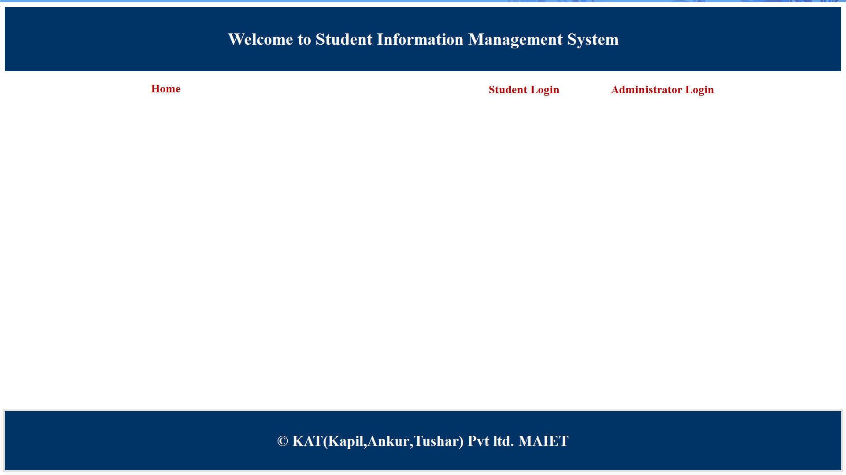
SNAPSHOTS
This is the homepage/indexpage of the site.

Slide 96
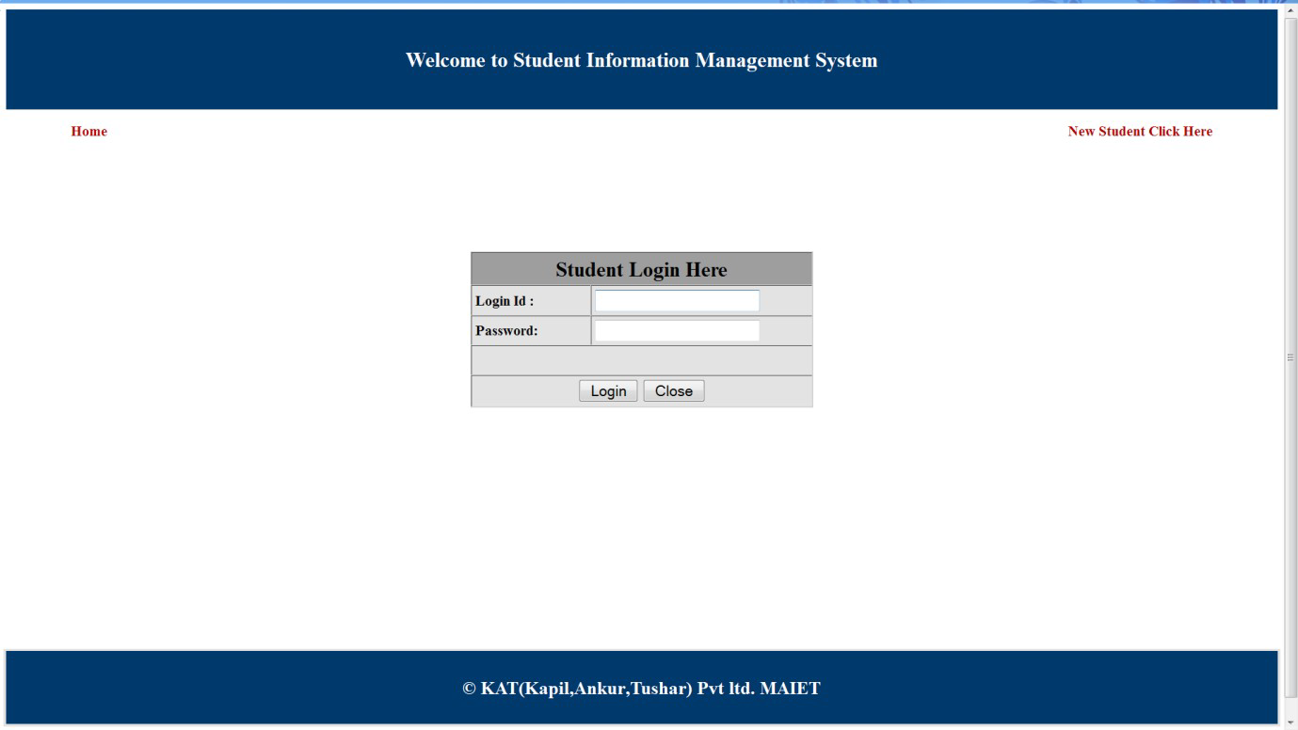
This is the student login page.

Slide 97
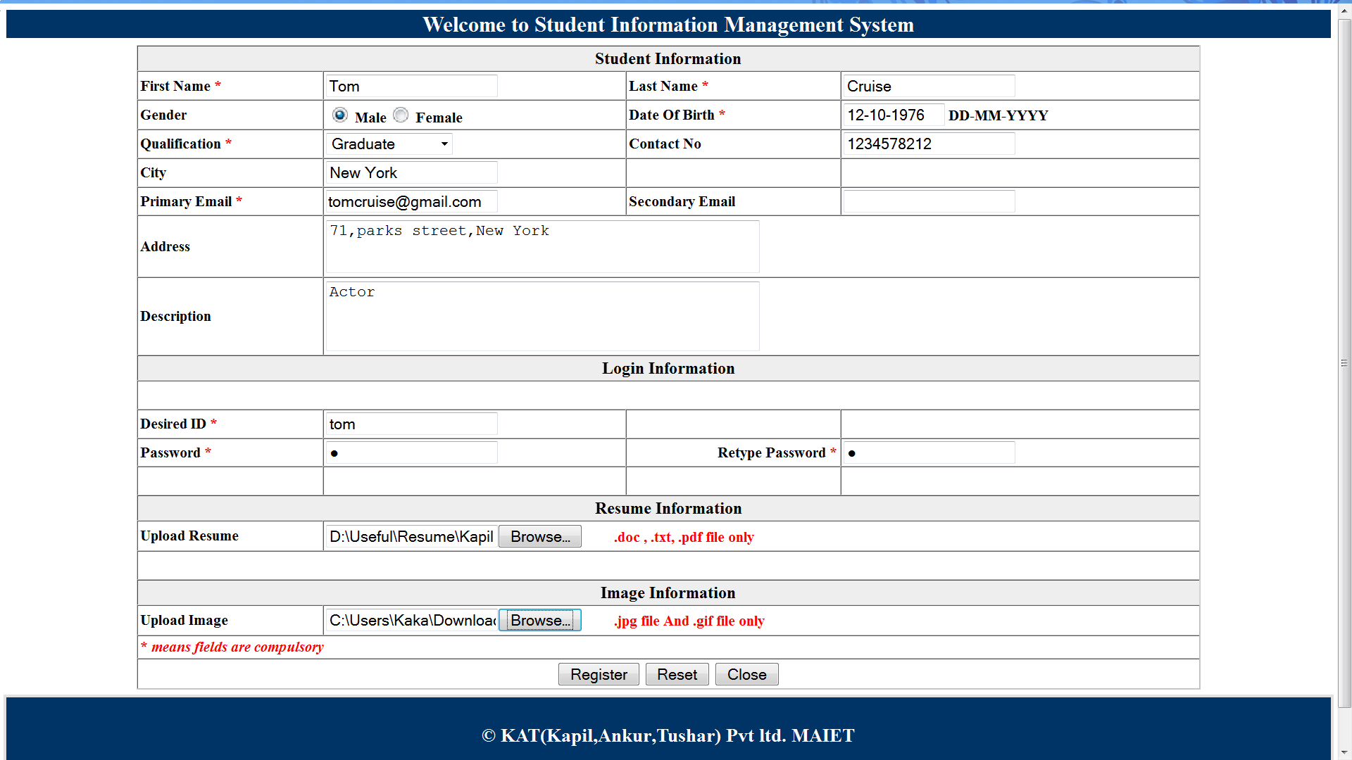
This is the registration page where students can register online.

Slide 98

After successful registration the user account needs to be first enabled by the administrator.The students can then login into their accounts with the id and password they choose during registration.The above page shows student login page.

Slide 99
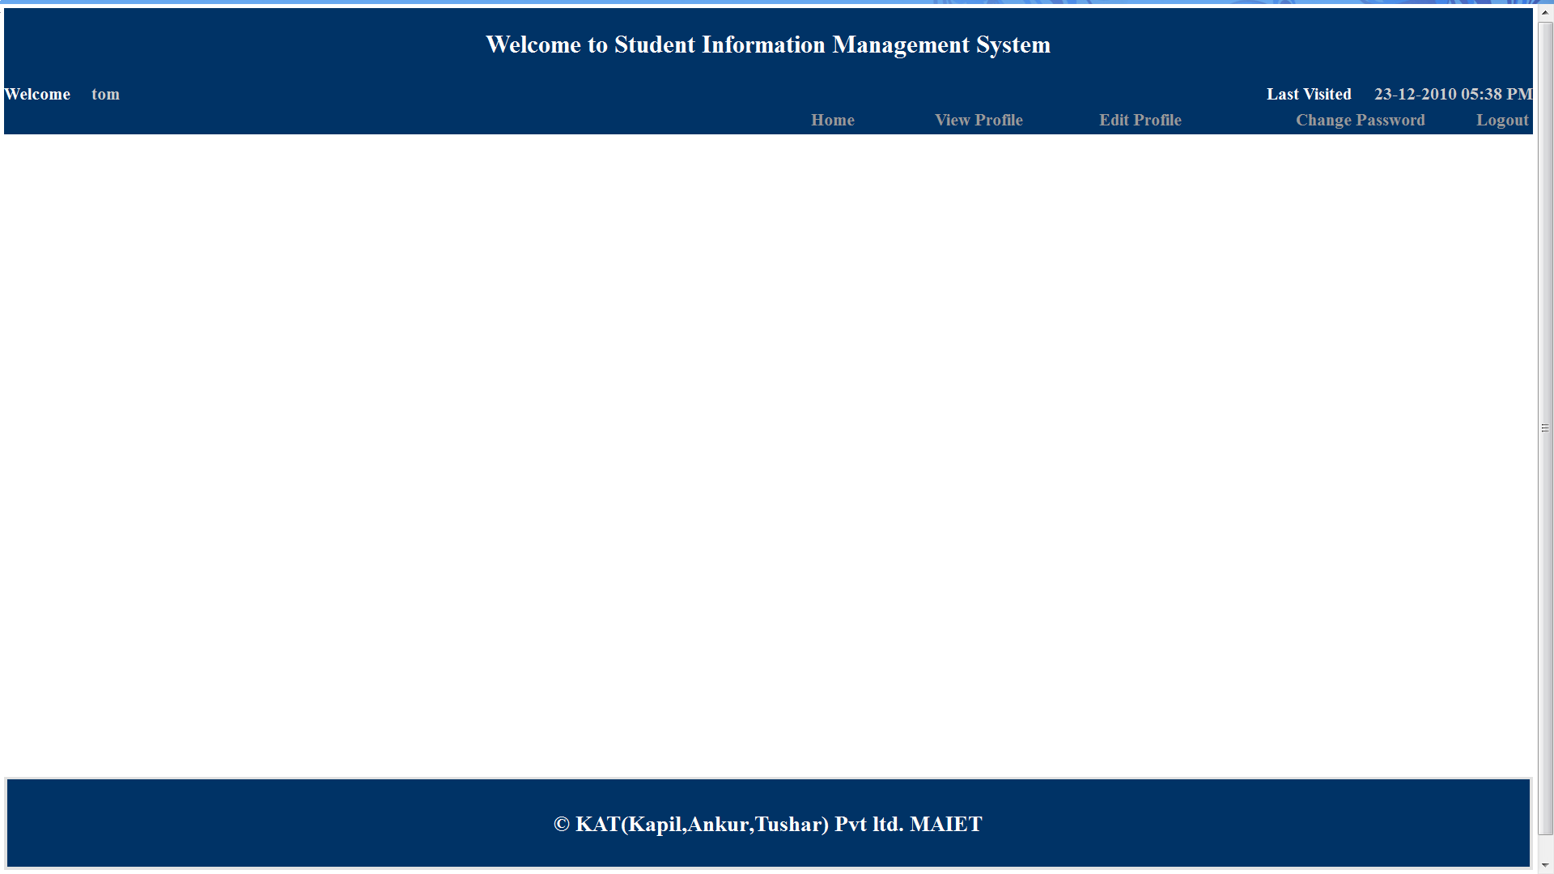
After logging in the student home page is opened as shown above

Slide 100
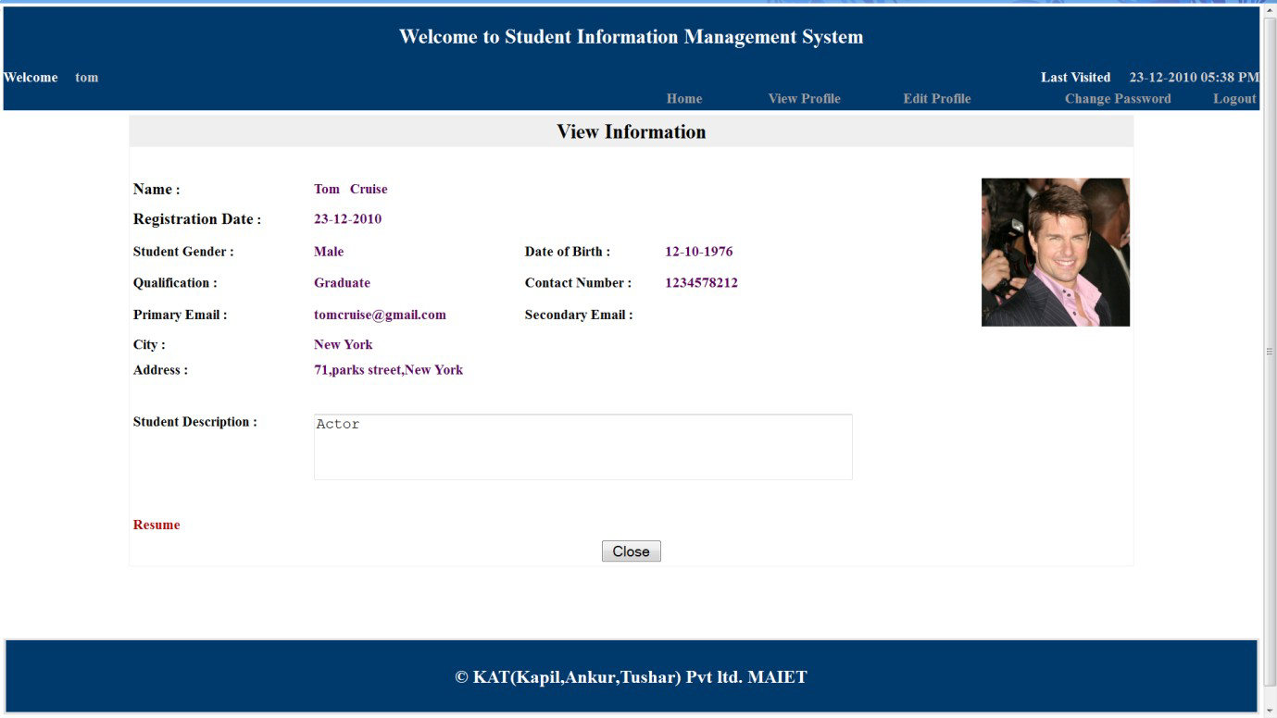
The student can view their profile.The above page shows the user profile.The link to the resume is shown if a resume was uploaded during registration otherwise its not shown.

Slide 101
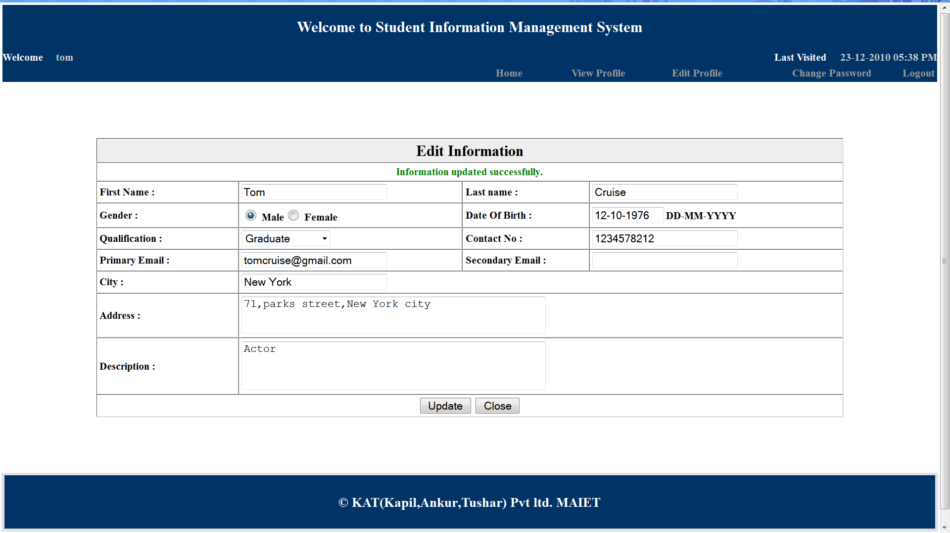
Students can edit their profiles by using the edit profile option on their homepage.The above page is
used for editing student information.

Slide 102
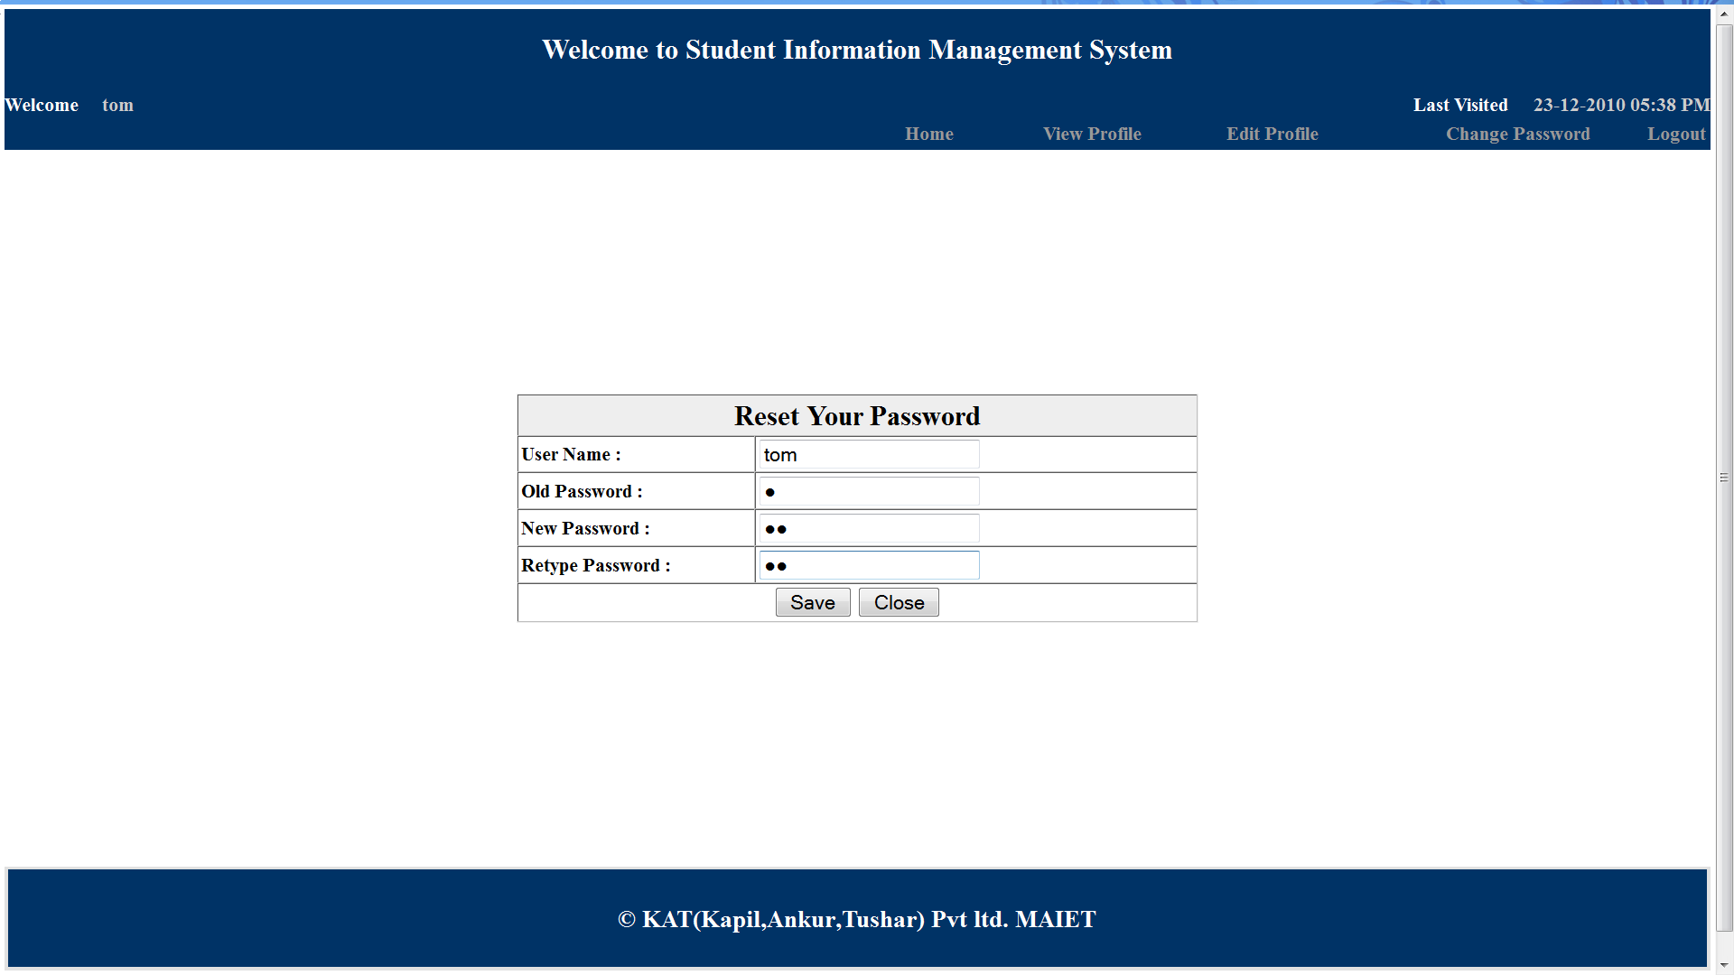
The students have the option to change their password.They need their old password in order
to change the password.

Slide 103
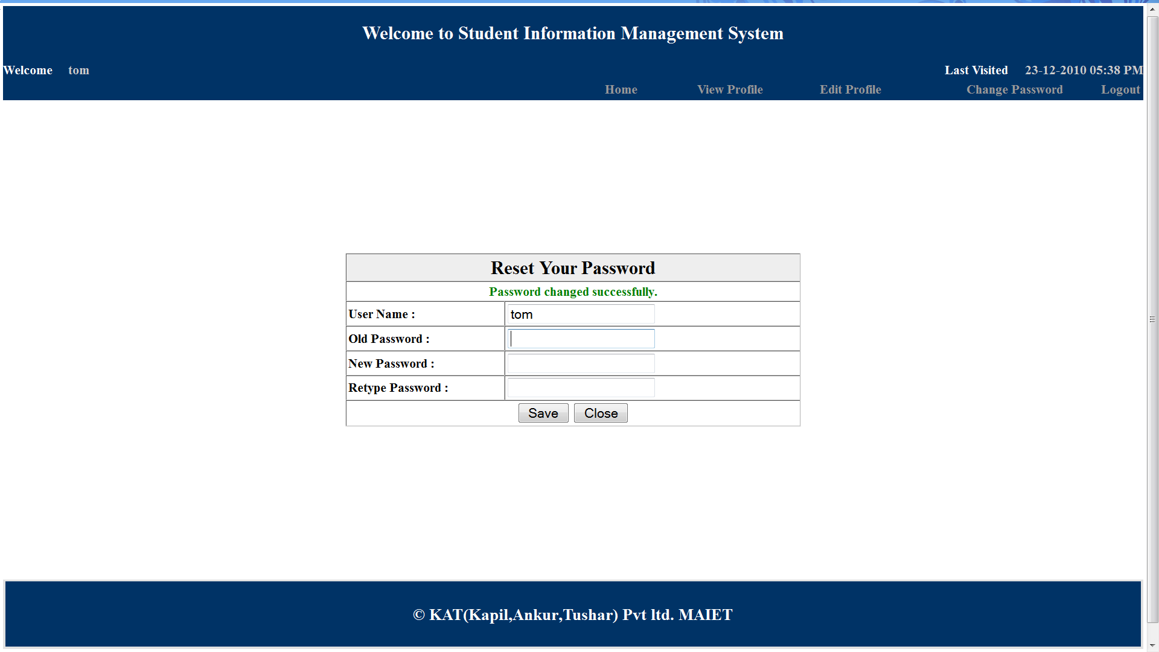
After successful operation a password change notification is displayed to the user.

Slide 104
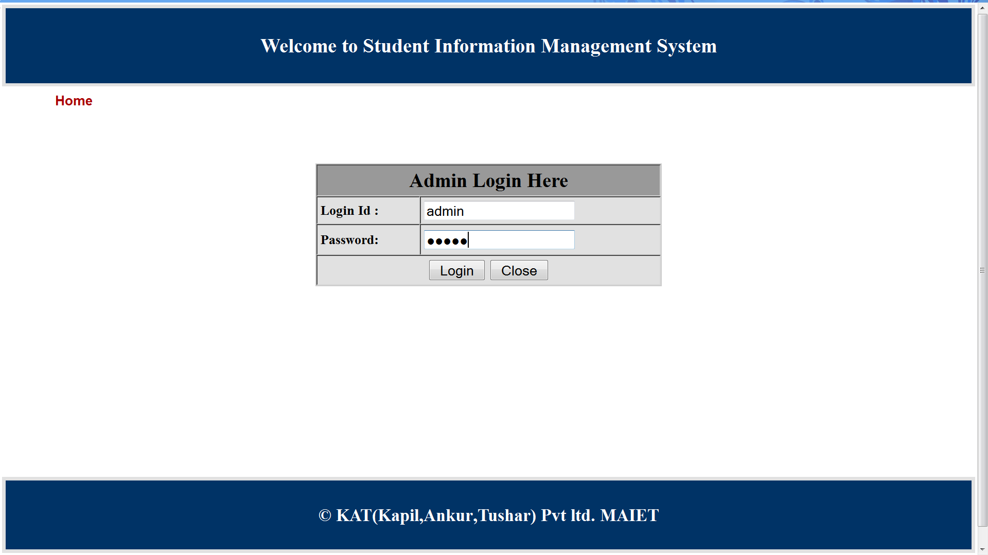
The above page is the administrator login page. It requires the administrator username and password

Slide 105
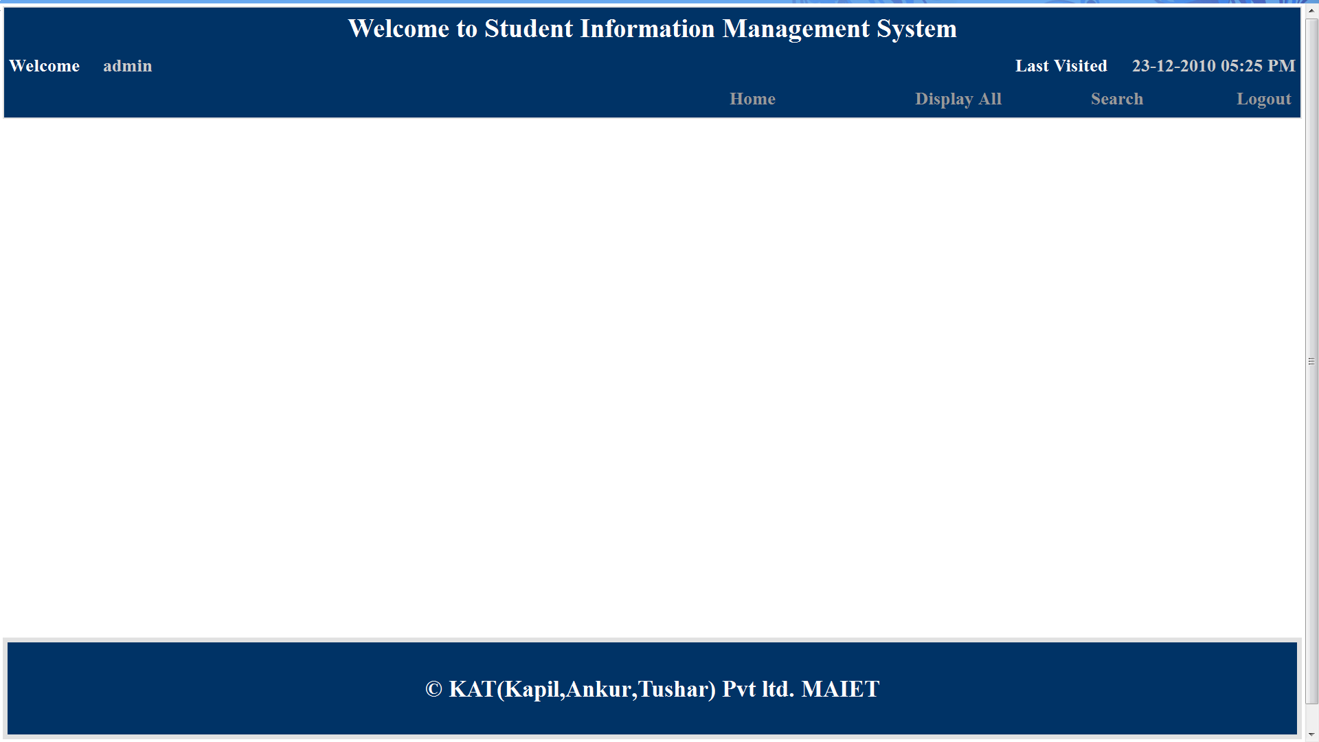
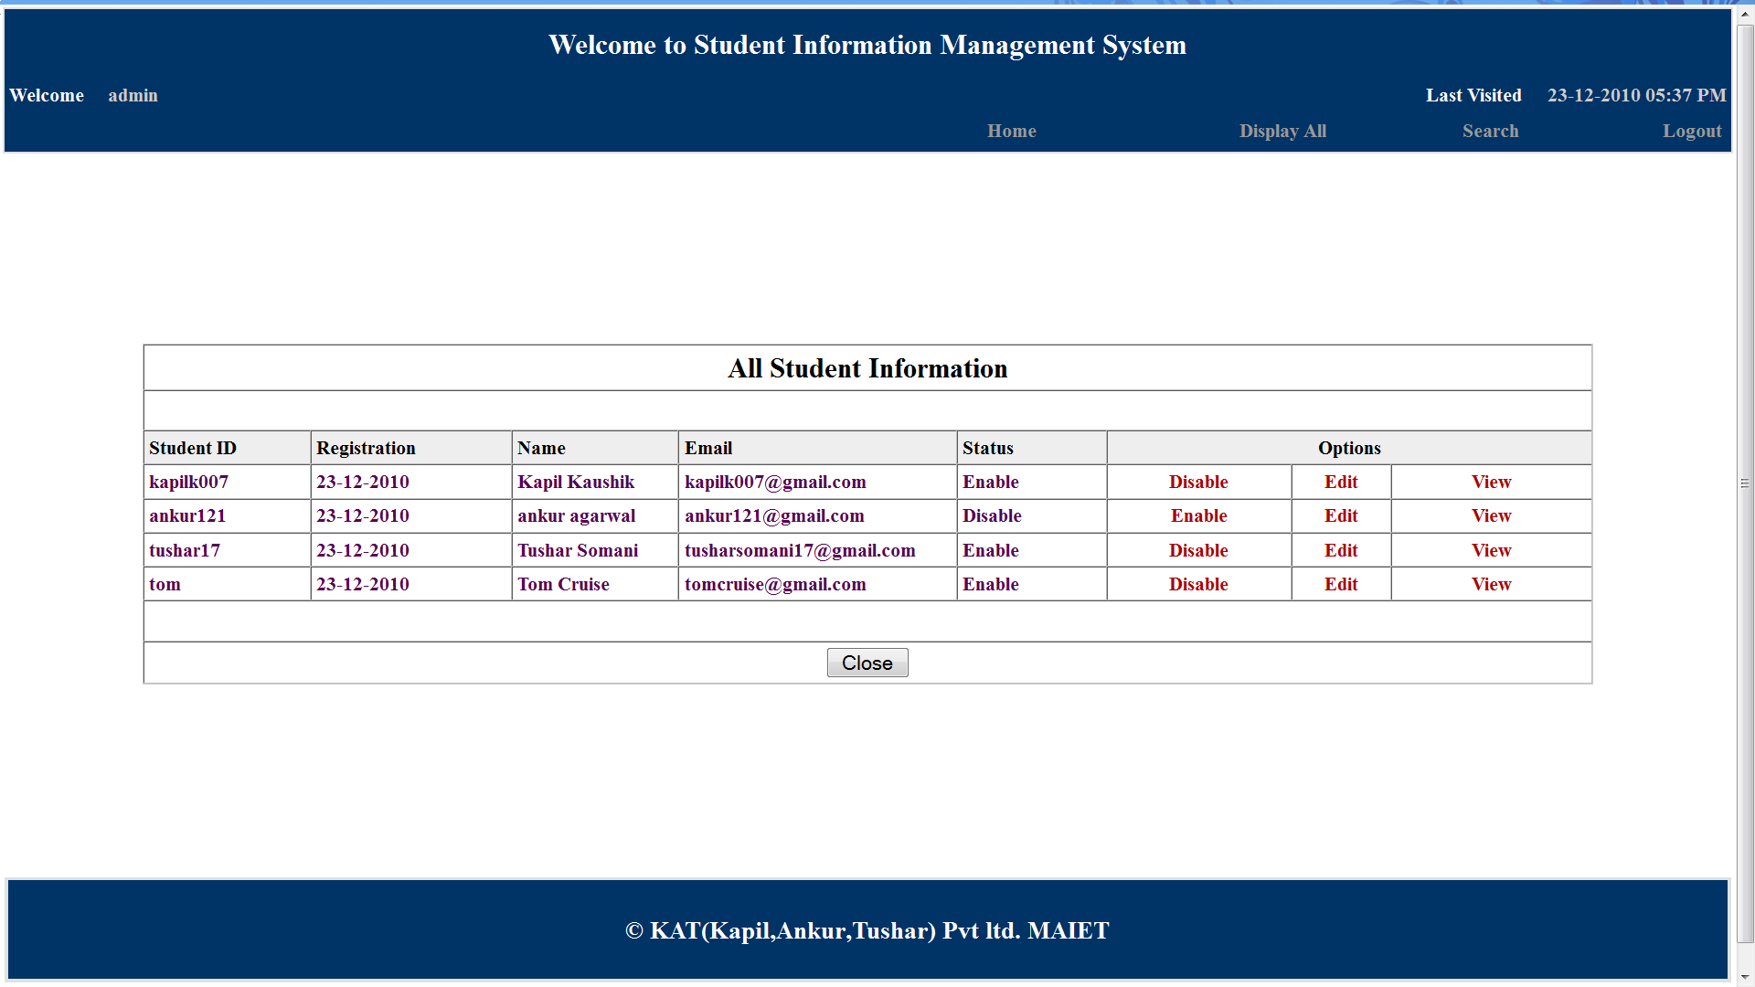
This is the displayall page wherein the administrator can see all the registered
students.He can enable/disable their accounts as well as view/edit students
information.
This is the homepage of administrator.
This is the displayall page wherein the administrator can see all the registered students.He can enable/disable their accounts as well as view/edit students information.

Slide 106
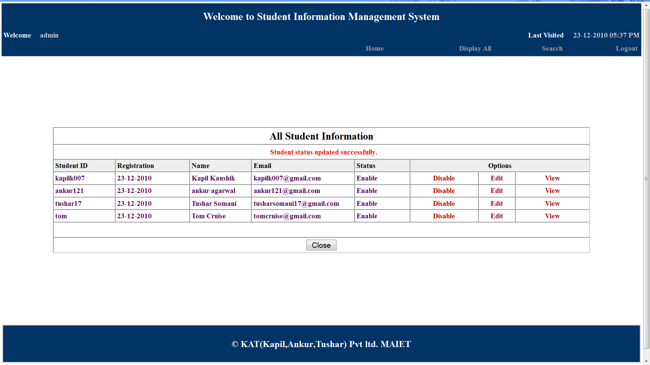
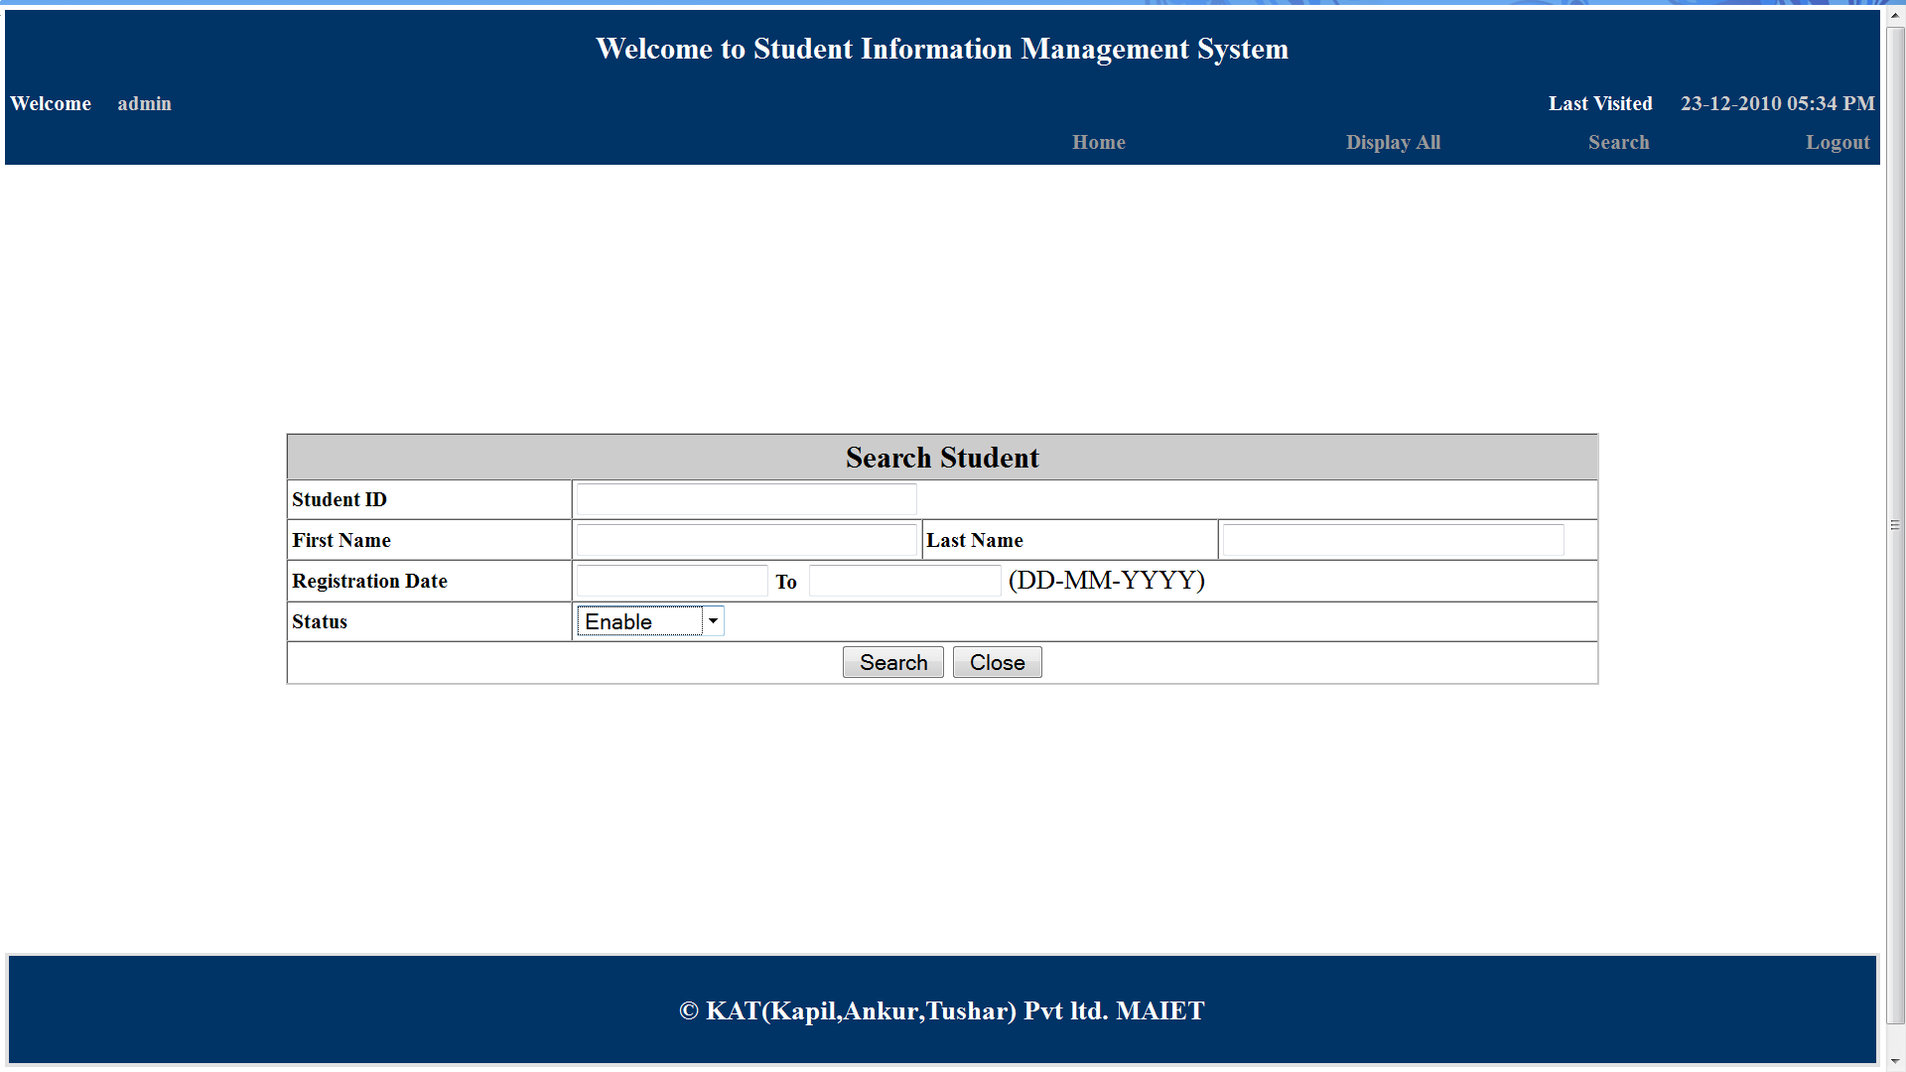
This page shows the change in account status.After successful change a message is displayed to the administrator
This is the search page and it provides search function to the administrator.Here we search
for all the students with theirs accounts enabled.

Slide 107
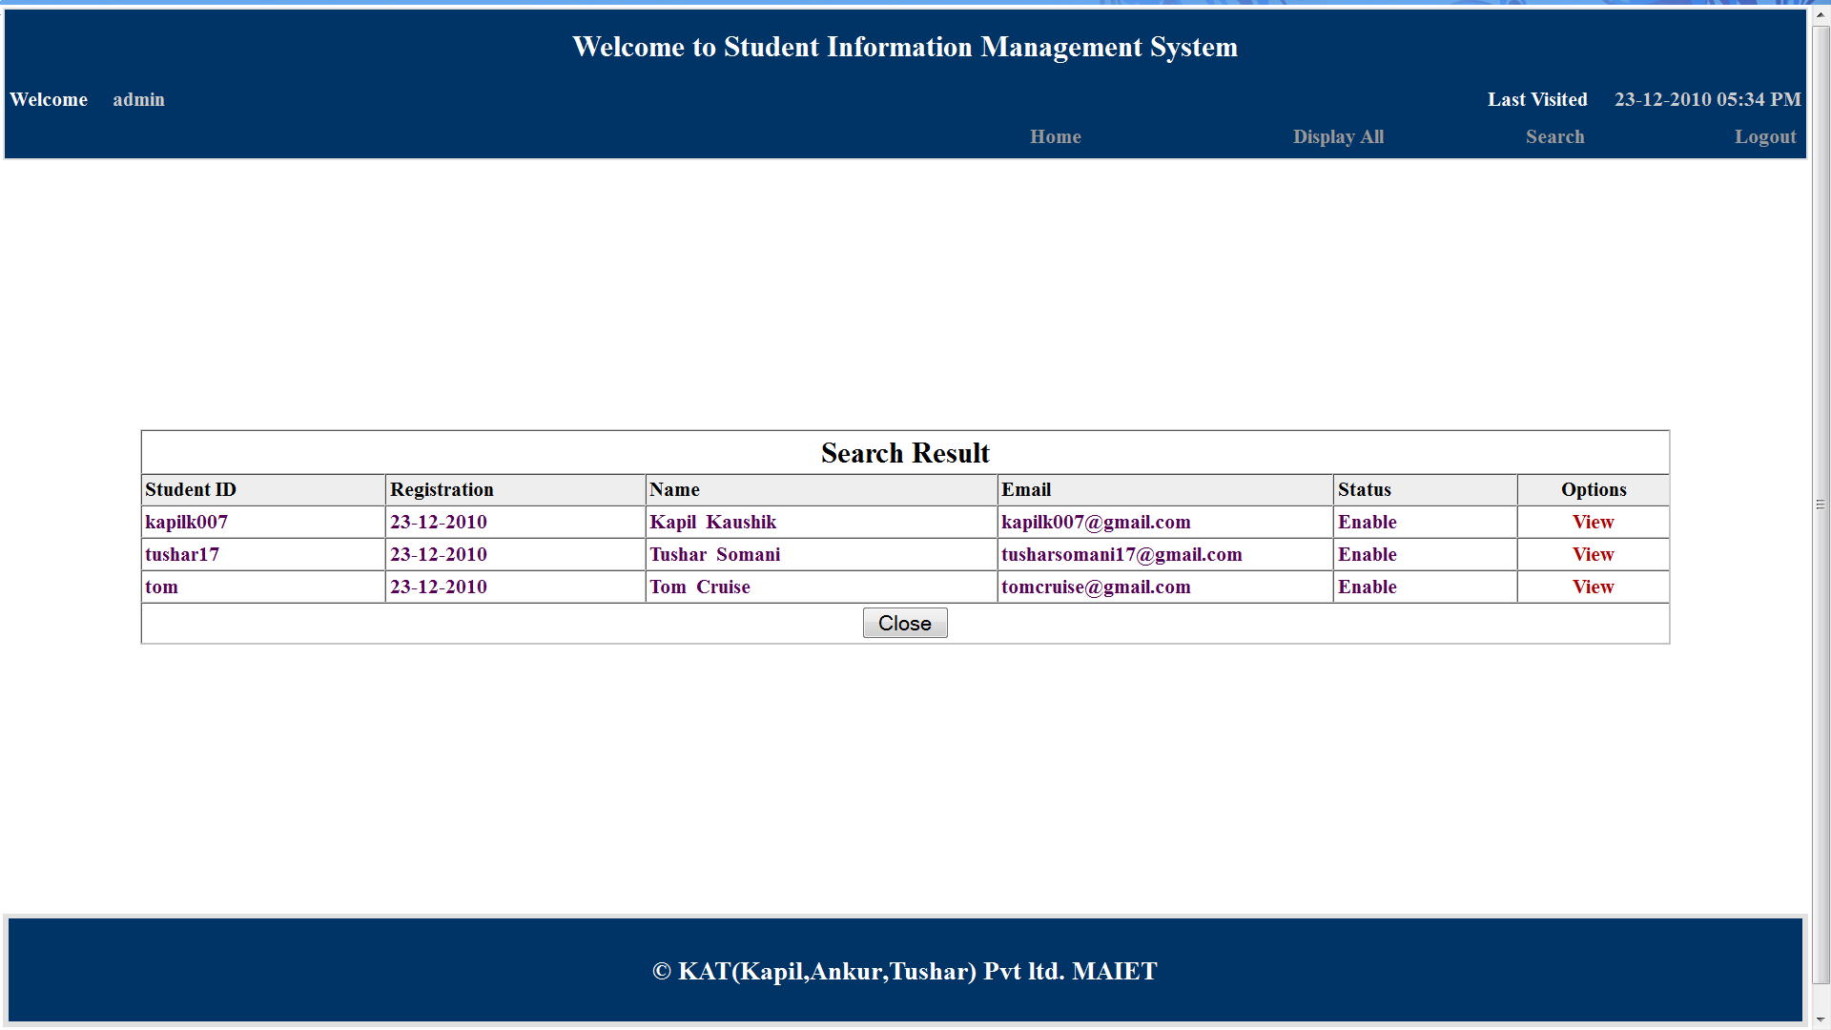
This is the search result display page.The administrator can view profile of any of the searched students from here.If there are no results then an appropriate message is displayed.

Slide 108
SCOPE OF THE PROJECT
The Student Information Management System
(SIMS) can be enhanced to include some other functionality like marks , attendance management.
Talent management of students based on their performance evaluation can be added.
Social networking can also be added wherein students can interact with each other.
Online class functionality can be added.
Can evolve as an online institution.
Functionality of chat and messages can be added.
Online exam functionality can be added.
Online resume builder functionality can also be added.

Slide 109
Limitations
Limitations of existing system Basically, a student information management system offers a 360-degree view of students. And this helps monitor, track and improve the educational performance and several other aspects of students. It helps you manage all the student-related data in a well-organized manner.
A Student Information Management System gives you a unique ID against every student. And using that ID, you can easily track the fee status, assignments, exam results, grades, parent info within seconds.
Similar to the students, the teachers also become more productive with a student management system. It’s because, with a system in place, teachers won’t have to manually take attendance, manage timetables and assignments.
Everything can be loaded on the management Software, which can be accessed by all.
This way, teachers can focus more on academics and learning than administrative tasks.
If you have a software managing all the records, you won’t have to purchase/maintain huge piles of paper based records . This way you can save some money.
Although it may not be a huge saving, “a penny saved
is a penny earned.”

Slide 110
There aren’t any limitations of a student management system as such. A better word for limitations would be “issues” faced by schools while using a student management system.
Fortunately, there aren’t many.
The most common issues are schools/teachers/students/parents face while using a student management system is: a complex user interface and that’s a solvable issue.
We’re humans and we need some time to get a hang of things. If the tool you’re using is genuinely tough to use, you can go for a tool that’s simple or get a training.
Often, applications face minor technical glitches and these systems are no exception but, ratification is immediate.
Only, people who are accustomed to regular use of smartphones or computers can operate this software.
Extensive modules and features make it difficult for a user to utilise the application.
With huge flow in traffic the application is prone to performance issues.
Few companies market their products at extravagant price, which are not affordable by
growing organizations.

Slide 111
TESTING
Software testing is the process of executing a program with an intension of finding errors. This can also be stated as the process of validating and verifying that a software program is working as expected and is meeting the technical as well as business requirements. This can be implemented at any time in the development process. There are many types of testing software viz., unit testing, black box testing, performance testing, stress testing, regression testing, white box testing etc.
SOFTWARE TESTING TYPE
BLACKBOX TESTING
The black-box approach is a testing method in which test data are derived from the specified functional requirements without regard to the final program structure .It is also termed data-driven or requirements-based testing . A testing method emphasized on executing the functions and examination of their input and output data.

Slide 112
WHITE BOX TESTING
Contrary to black-box testing software is viewed as a whitebox , or glass-box in white-box testing as the structure and flow of the software under test are visible to the tester . This testing is based on knowledge of the internal logic of an application’s code. Testing plans are made according to the details of the software implementation, such as programming language, logic and styles. Test cases are derived from the program structure. White-box testing is also called glass-box testing, logic-driven testing or design based testing.
BENEFITS
Software provide easy management of student records.
Software has very user friendly interface which is very easy to handle and understand .
Software provides security to private data by hiding them.
Software uses very less memory and takes less time to startup.

Slide 113
CONTRIBUTION IN THE PROJECT
Student information management system lead to a better organization structure since the information management of the students is well structured and also lead to better as well as efficient utilization of resources.
Student Information Management System can be used by education institutes to maintain the records of students easily. Achieving this objective is difficult using a manual system as the information is scattered, can be redundant and collecting
relevant information may be very time consuming.
All these problems are solved using this project.
Our project “Student Information Management System” was developed by all four of us.
We, a team of two persons took a step by step approach in order to reach our goal.
We applied the knowledge we gained from our respected teachers and developed this project “STUDENT INFORMATION MANAGEMENT SYSTEM”.

Slide 114
Bibliography
PHP book by Vasvani (TMH publications).
Beginning PHP5 by WROX.
www.google.com
www.wikipedia.com
www.w3schools.com
Informatics practices by Sumita Arora.
Head First PHP & MySQL by Lynn Beighley and Michael Morrison(O’Reilly)

